Slide 1



Prepared by Group 12
Final Presentation
SMARTNAV CANE: A Sensor-Integrated Mobility Aid for Enhanced Navigation
Jul 22, 2025

Slide 2




Team Members
Evans Bakire
Brennan Russell
Sharifah Alselahi
Computer Engineering
Electrical Engineering
Computer Engineering
Deon McCoy
Yussef Abdelbary
Electrical Engineering
Computer Engineering

Slide 3
Introduction
As part of our Senior Design project, my team and I set out to create a meaningful and practical solution to help individuals with visual impairments navigate the world more safely and independently. Our project, the SmartNav Cane, is a smart mobility aid that combines sensor technology, GPS navigation, and intuitive user feedback in the form of audio cues. The idea was driven by both technical curiosity and personal motivation—several of us have family members with visual impairments, and we’ve seen firsthand the daily challenges they face when it comes to mobility.

Slide 4
Motivation and Background
Traditional white canes lack smart features (e.g., obstacle detection, navigation)
Navigating unfamiliar or busy environments remains difficult
Personal connection: team members with visually impaired relatives
Existing tools (WeWALK, Sunu Band) — limited by range, no GPS
Need for improved real-time guidance and detection
Goal: boost user independence and confidence through smart mobility
.

Slide 5
Goals and Objectives
Basic
Goals
Advanced
Goals
Stretch
Goals
SMART
Objectives
🔧
🚀
🛰️
🎯
Detect nearby obstacles in real time using proximity sensors.
Provide accurate GPS-based navigation assistance.
Ensure the cane is lightweight for ergonomic use.
Dynamically recalculate the route if the user goes off track.
System Battery Status Feedback
Optimize power usage to ensure longer operation time.
Integrate AI-powered object recognition for better environment
awareness.
Add an emergency
SOS button for location sharing in critical situations.
Develop mobile app for route planning and remote settings.
Achieve ≥ 85% obstacle detection accuracy.
Keep power consumption ≤ 5W.
Implement a system for real-time GPS-based route guidance

Slide 6
System Specifications
System Parameters | Description | Specification
System Weight | Weight of the entire system | ≤ 3 lbs.
Feedback Response Time | Time elapsed from detection to alert transmission | ≤ 500 milliseconds
Navigation Accuracy | Maximum deviation from target location | ≤ 5 meters.
Power Consumption | System's power requirements | ≤ 5W
Voice Recognition Accuracy | Processing accuracy of system data from voice command inputs | ≥ 95%
Object Detection Accuracy | Percentage of objects correctly identified | ≥ 85%

Slide 7
Component Specifications
Component | Key Spec | Value
ToF Sensor | Detection Range | Up to 1m
IR Sensor | Voltage Range | 4.5 - 5.5V
Microphone (MEMS) | Signal-to Noise Ratio | ≥ 60 dB
GPS Location Accuracy | The GPS module delivers data points with exact positional values | ≤ 3 meters deviation
SD Card | System External Storage Capacity | ≤ 63 GB

Slide 8
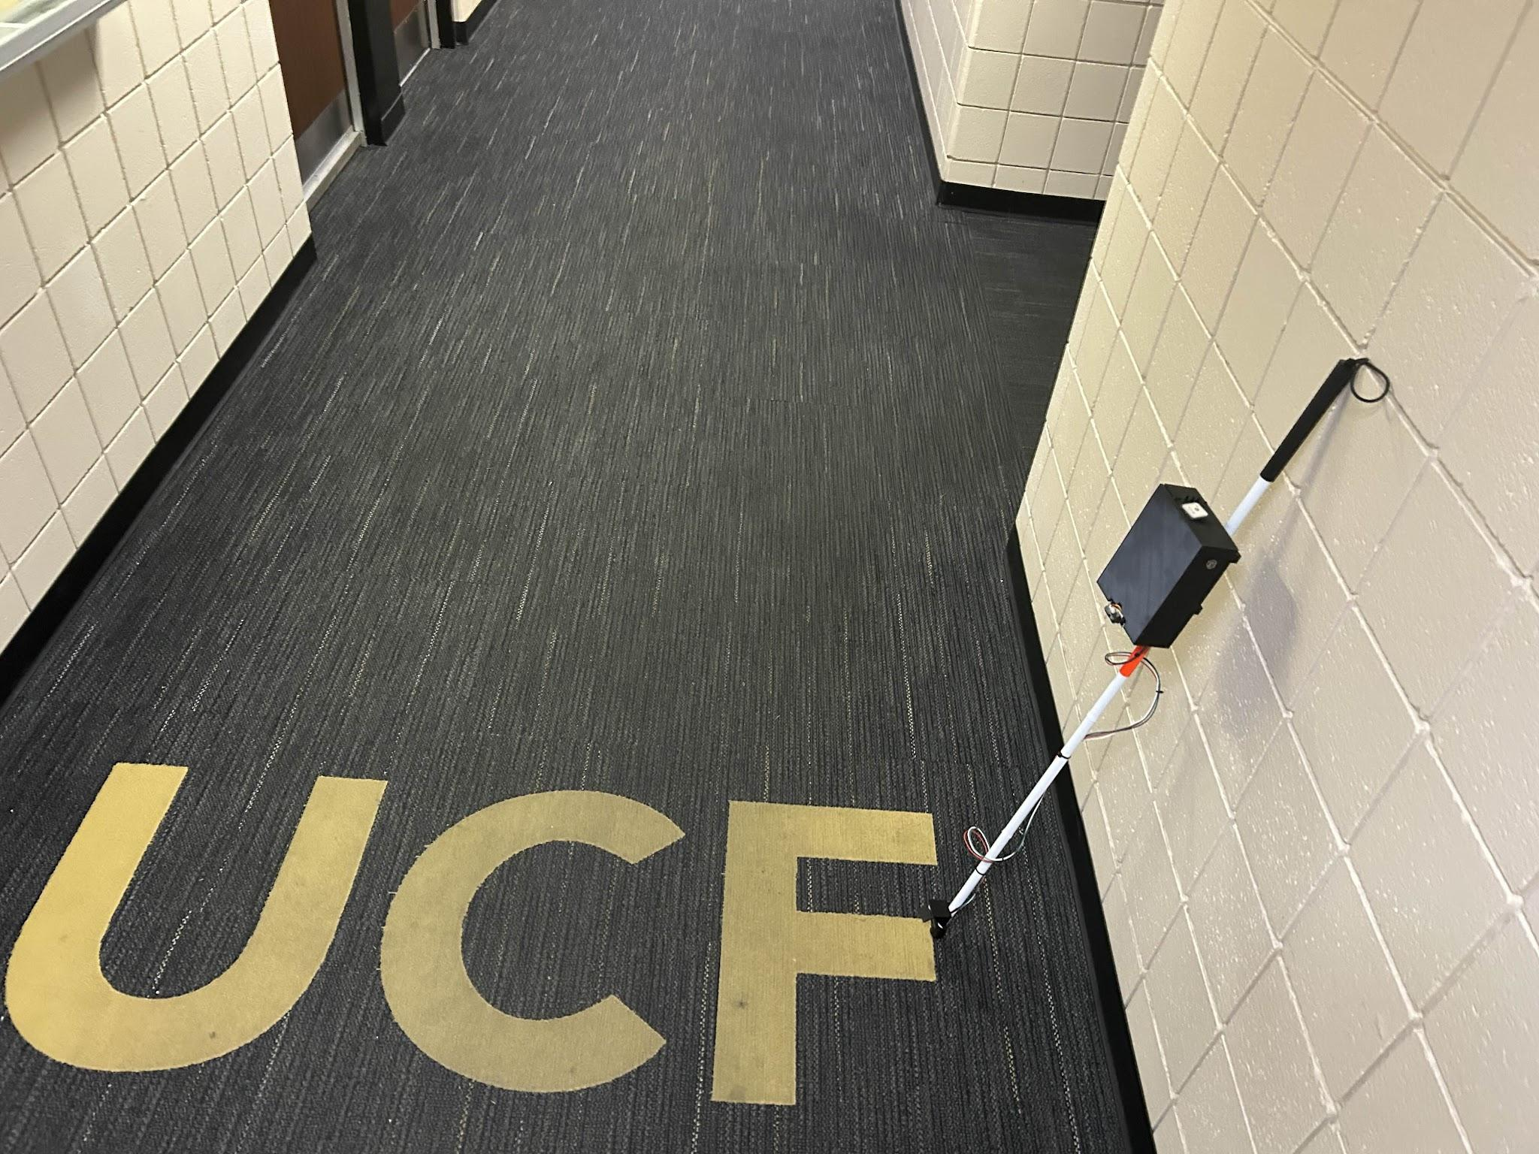
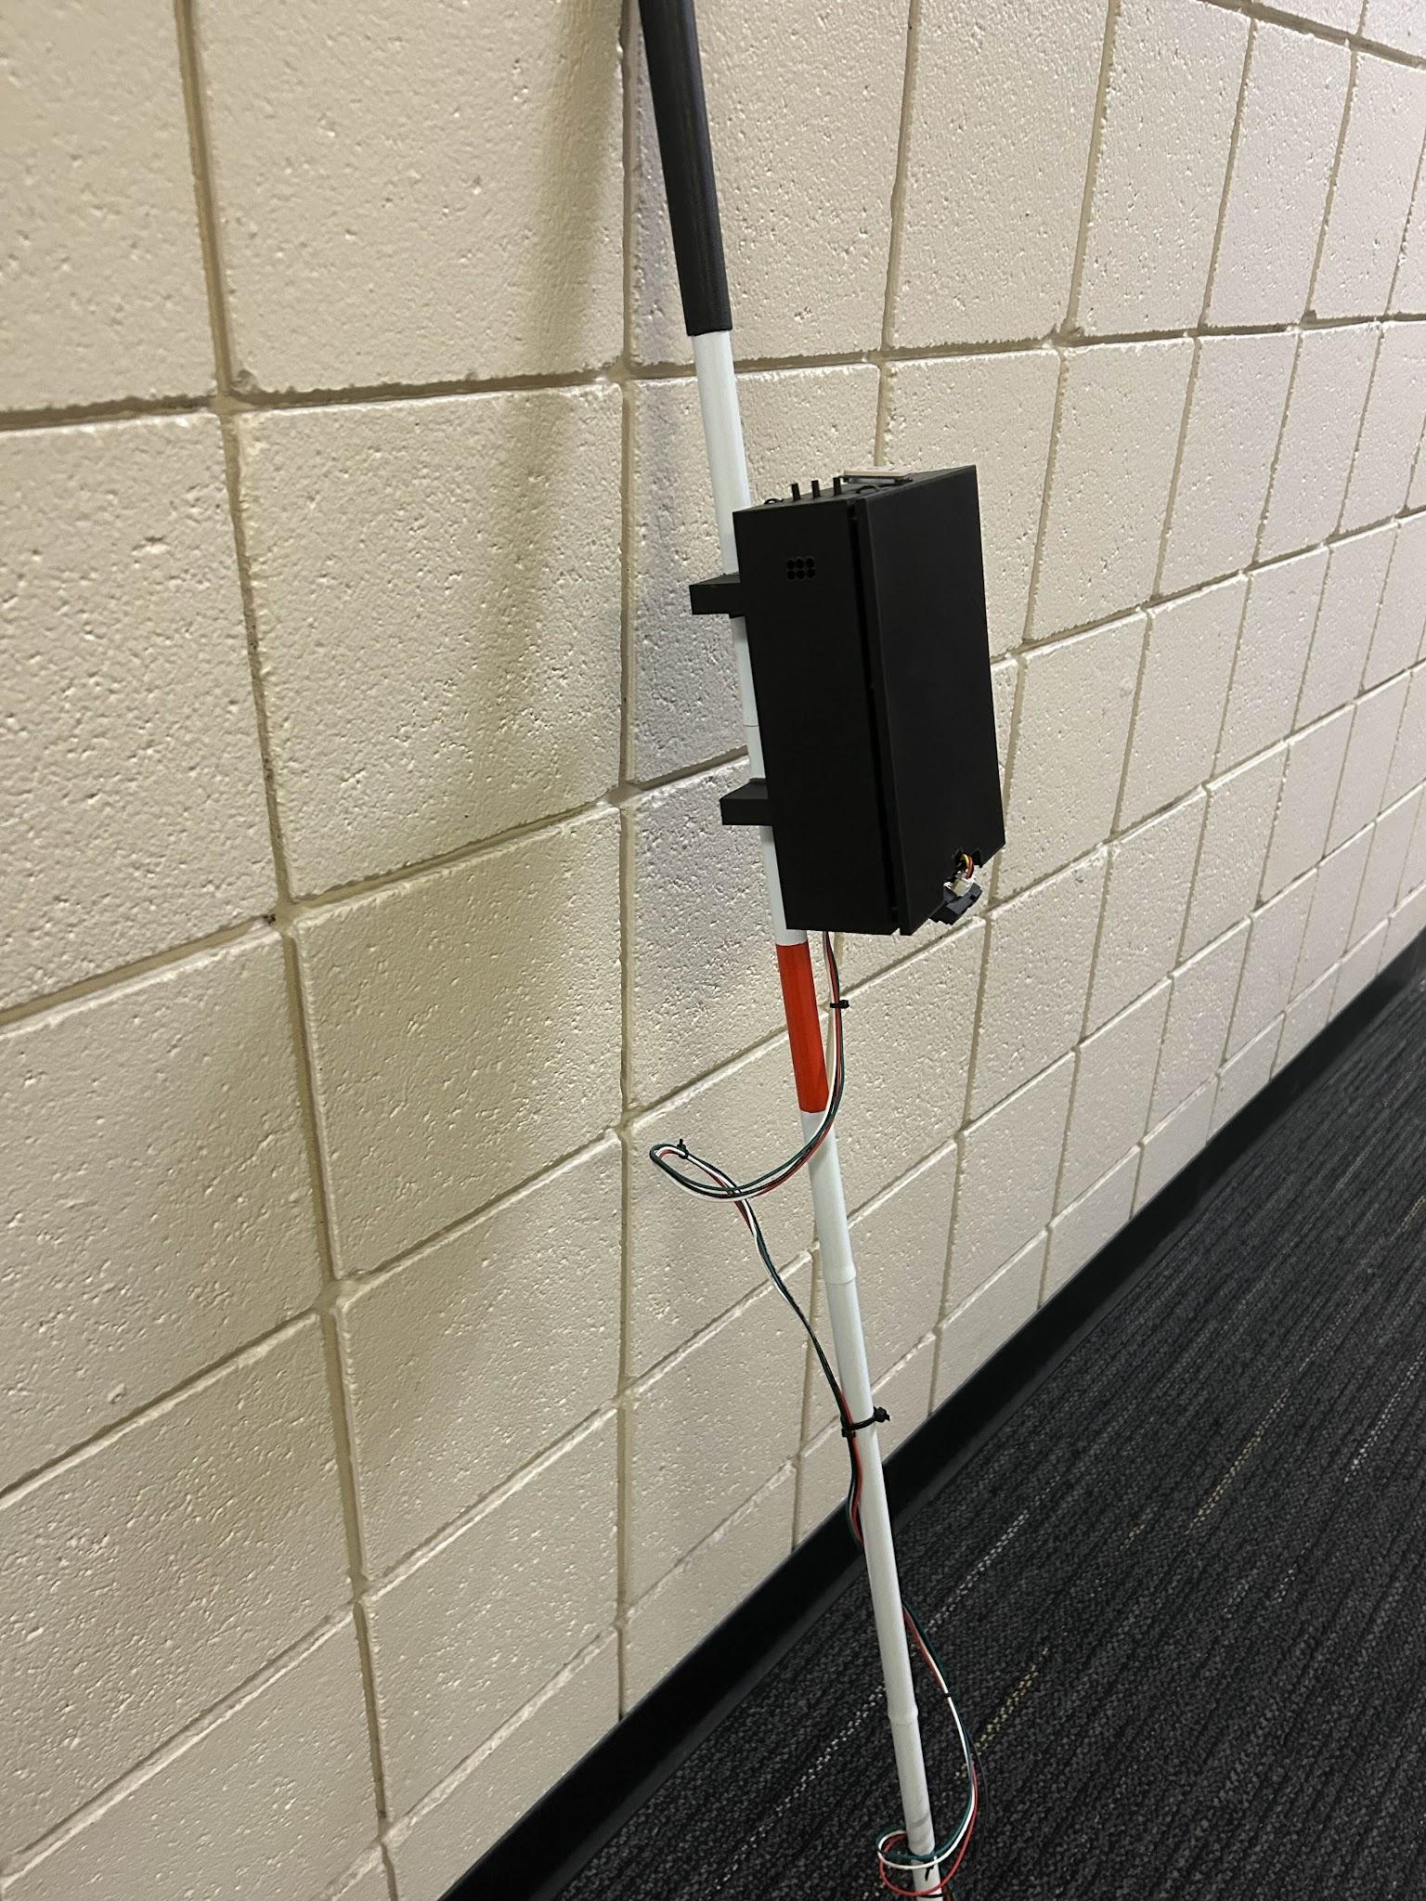
SmartNav Cane – Physical Conceptualization

Slide 9
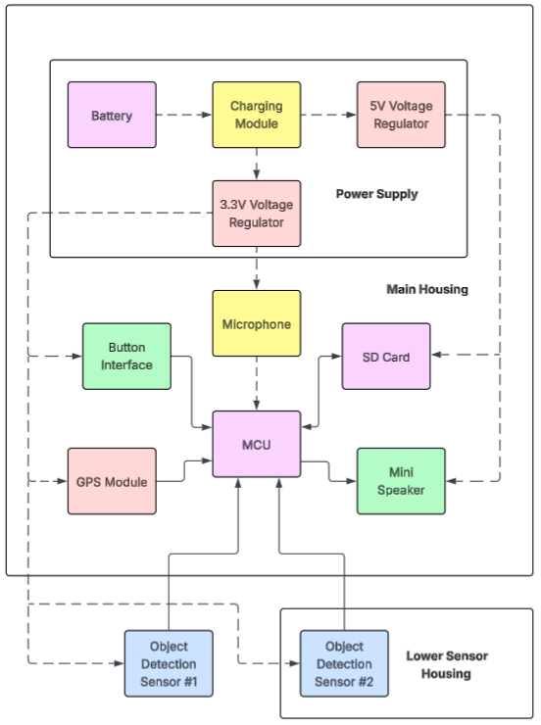
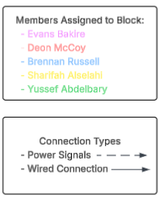
Hardware Block
Diagram

Slide 10
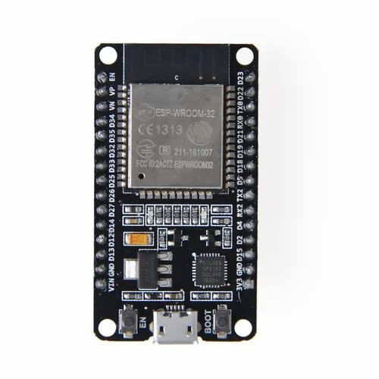
Arduino and MSP430 lacked sufficient processing power and memory for our needs
ESP32 chosen for its:
  Higher processing power
  Largest memory
  Built-in Wifi / Bluetooth support
Despite these advantages, we initially had concerns about whether the ESP’s memory would be enough
Hardware Component (MCU)
Parameter | ESP 32 Wroom 32 | Arduino (ATmega328P) | MSP430FR6989
Processing Power | 240 Mhz | 18 Mhz | 16 MHz
RAM | 520 KB | 2 KB | 120 KB
WIFI Connectivity | Yes | No | No
Price | $6 | $3 | $4
GPIO Pins | 36 | 23 | 83
Cores | Dual | Single | Single
Bluetooth Connectivity | Yes | No | No

Slide 11
Different detection technologies chosen for each sensor
Lidar and mmWave were ruled out early due to high cost
Photoelectric sensors offered high accuracy and easy integration, but were sensitive to lighting conditions
Ultrasonic was a potential alternative to infrared, but had a slightly lower detection range
Time-of- Flight and Infrared chosen for:
  Desirable detection ranges
  Moderate to high accuracy
  Easy integration with our system
Hardware Technology (Object Detection)
Parameter | ToF | Lidar | Ultrasonic | Photoelectric | mmWave | IR Distance
Principle | Light delay | Laser scan | Sound echo | IR reflect | EM reflect | Triangulation
Range | ~4m | 0.1–12m | 2cm–4m | 0–100m | 3–10m | 1–5m
Accuracy | High | Very High | Mod | High | High | Mod
Field of View | Var | Wide | Narrow | Var | Wide | Narrow
Robust | Good | Good | Good | Med | Med | Med
Cost | Med | High | Low | Med | High | Low
Power | Low | Med | Low | Low | Low | Low
Integration | Easy | Mod | Easy | Easy | Hard | Easy
Pros | Precise, fast | 3D mapping | Low cost; works in dark | Fast; versatile | Detects moving; wide cover | Effective for ground
Cons | Timing critical; range limited | Complex; costly | Noise sensitive; low res | Light dependent | Weather sensitive; complex | Limited range; narrow FoV

Slide 12
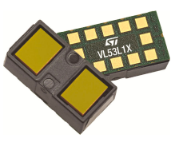
Both VL53L0X and VL6180X had shorter detection ranges than desired
VL53L0X had slowest response time, but offered a wide Field of View
Vl6180X had fastest response time, but a narrow Field of View
VL53L1X was chosen for its:
  Extended detection range
  Adjustable Field of View
  High accuracy in various environments
Hardware Component (ToF Sensor)
Parameter | VL53L1X | VL53L0X | VL6180X
Detection Range | Up to 4m | Up to 2m | Under 1m
Accuracy | Millimeter-level | Millimeter-level | Millimeter-level
Field of View | Adjustable | Wide | Narrow
Power Consumption | Moderate | Low | Very Low
Price | Mod | Low | Low
Integration Complexity | Moderate | Low | Low
Response Time | Moderate / Fast | Fast | Very Fast
Operating Voltage | 3.3V | 3.3V | 3.3V
Interface | I2C | I2C | I2C

Slide 13
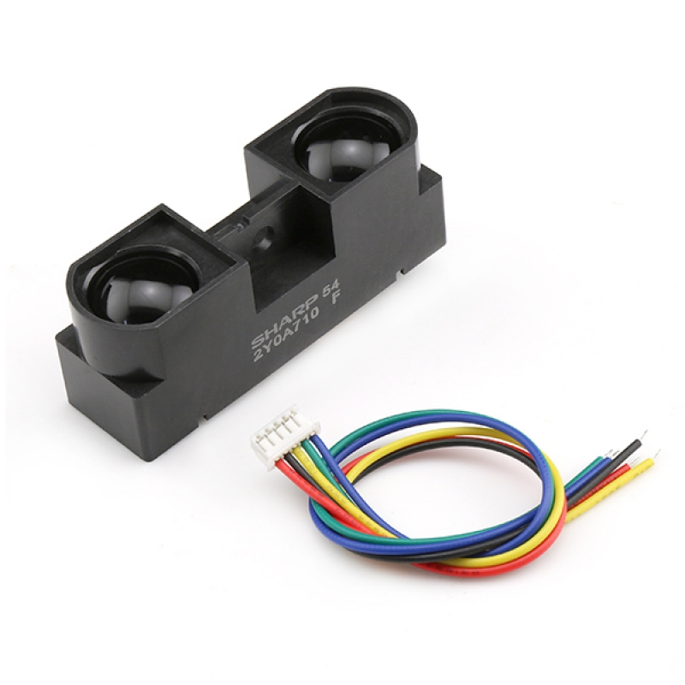
GP2Y0A21YK0F ruled out due to short detection range and lowest accuracy
GP2Y0A41SK0F was a strong candidate with low power consumption and detection range
GP2Y0A710K0F was chosen for its::
  Extended detection range
  High accuracy
Hardware Component (IR Sensor)
Parameter | Sharp GP2Y0A710K0F | Sharp GP2Y0A21YK0F | Sharp GP2Y0A41SK0F
Range | 1 – 5.5 m | Up to 1m | Up to 4 m
Price | $12 | $5.65 | $8.18
Current Draw | Typ. 30 mA | 25 mA | 20 mA
Supply Voltage | 4.5 – 5.5 V | 4.5 – 5.5 V | 4.5 – 5.5 V
Footprint | 58 × 17.6 × 22.5 mm | 44.5 × 18.9 × 13.5 mm | 40 × 20 × 13.5 mm
Accuracy | High Accuracy | Moderate Accuracy | High Accuracy

Slide 14
Electret condenser microphones slightly more complex to implement
Analog MEMS microphone had higher noise performance compared to digital MEMS
Digital MEMS Microphone was chosen because of:
  Slightly lower power consumption
  More compact size
  Easy integration
  Low noise performance
Hardware Technology (Microphone)
Parameter | Digital MEMS Microphones | Analog MEMS Microphones | Electret Condenser Microphones
Operating Principle | Capacitive, I²S | Capacitive, Analog | Electric, Analog
Signal Output | Digital (I²S) | Analog | Analog
Frequency Range (Hz) | 20-20k | 20-20k | 20-20k
Power Consumption | ~0.5 mA | ~1 mA | ~1 mA+
Size | ~3×3×1 mm | ~3×3×1 mm | ~6x10x1 mm
Integration Complexity | Low | Moderate | High
Noise Performance | Low | Moderate | Moderate
Sensitivity | ~60-65 dB | ~60-65 dB | ~55-60 dB

Slide 15
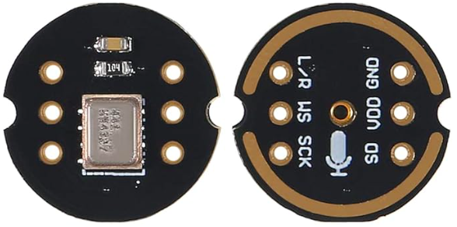
SPH0645LM4H‑B ruled out with lowest sample rate of options
Very similar qualities between INMP441 and ICS-43434
INMP441 chosen for its:
  Signal-to-Noise ratio
  Max sampling rate
Hardware Component (MEMS Microphones)
Parameter | INMP441 | SPH0645LM4H‑B | ICS‑43434
Frequency Response (Hz) | 20Hz - 20kHz | 20Hz - 20kHz | 20Hz - 20kHz
Signal-to-Noise Ratio (dB) | 60 dB | 65 dB | 60 dB
Operating Voltage (V) | 3.3 V | 1.8 - 3.3 V | 1.8 - 3.3 V
Price | $3 | $2.5 | $2
Max Sample Rate | 96 kHz | 48 kHz | 96 kHz
Package (mm) | 3 × 4 × 1 | 3 × 3 × 0.95 | 3.5 × 2.65 × 0.98

Slide 16
GPS Modules Comparisons
Parameter | NEO-M9N-00B | Neo-F10N-00B | ZED-F9P-05B | NEO-6M
Accuracy (CEP) Best (Assisted) | 2.0m 2.0m | 1.0m 1.0m | 1.5m 0.01m | <2.5m <2.0m
Multi-GNSS | GPS, GLONASS, Galileo, BeiDou | GPS, Galileo, BeiDou | GPS, GLONASS, Galileo, BeiDou | GPS
Max Update Rate | 25 Hz | 20 Hz | 18 Hz | 5 Hz
Power Consumption (Average) | 28mA Acquisit. 19mA Tracking | 26mA Acquisit. 27mA Tracking | 75mA Acquisit. 70 mA Tracking | 47mA Acquisit. 39mA Tracking
Voltage | 2.7 - 3.6 V | 2.7 - 3.6 V | 2.7 - 3.6 V | 3.1 - 5.5 V
Protocols Supported | UBX, NMEA 4.10, RTCM 3.3 | UBX, NMEA 4.11 | UBX, NMEA 4.11, RTCM 3.4, SPARTN 2.0.1 | UBX, NMEA 3.0
Communication INT. | UART, SPI, I2C USB | UART | UART, SPI, I2C USB | UART, USB, SPI, DDC
Dimensions(mm) | 16.0x12.2x2.4 | 16.0x12.2x2.4 | 21.8x16.8x2.2 | 16x12.2x2.4
Weight | 1.6g | 1.0g | 1.8g | 1.6g
Price (USD) Breakout Board | $27 $74.95 | $49 $39.95 | $129 249.95 | $6.75 $9.00
Accuracy
Update Rate
Low Power Consumption
Cost

Slide 17
The table below outlines current and voltage requirements for each major component in our system.
It guides power budgeting and ensures our PSU can handle peak loads without voltage drops.
Average current draw in the range of 100 to 300 mA.
Power Distribution Table
Component | Supply Voltage | Current
Esp 32 Wroom | 3 - 3.3 V | 100mA- 150mA
NEO-M9N-00B | 2.7 - 3.6 V | 50mA
Vl53L1x ToF | 2.6 - 3.5 V | 10mA
Sharp GP2Y0A710K0F | 4.5 - 5.5 V | 30 mA
SD Card module | 4.5 – 5.5 V | 40 mA
Gps module | 2.7 - 3.3V | 55 mA
INMP441 Mic | 3.3 V | 5 uA
max98357a Audio Amplifier | 3.3V - 5V | 10mA (Idle) - 100mA (Audio output)

Slide 18
Li-ion cells provide a stable 3.7 V output with good discharge characteristics, making them well-suited for powering embedded systems like ours.
Hardware Technology (Power Source)
Parameter | Lithium-Ion (Li-ion) | Lithium-Polymer (Li-Po)
Energy Density | High (~150–200 Wh/kg) | Medium (~100–130 Wh/kg)
Form Factor | Rigid (cylindrical, rectangular) | Flexible (can be flat/thin)
Weight | Light | Lighter
Design Flexibility | Low | High
Cycle Life | ~500–1000 cycles | ~300–600 cycles
Charge Time | Moderate (1.5–3 hrs) | Fast (1–2 hrs)
Self-Discharge Rate | Low | Very Low
Cost | Lower | Higher
Risk of Leakage | Medium | Very Low

Slide 19
We used a 18650 Li-ion cell due to its compact form factor and high capacity (~2600–3500 mAh) for extended operation.
Hardware Component (Power Source)
Parameter | 18650 Li-ion Battery | Flat Li-ion Pouch Battery
Form Factor | Cylindrical (18mm x 65mm) | Flat, flexible pouch
Capacity Range | 2500–3500mAh | 1000–3000mAh
Nominal Voltage | 3.7V | 3.7V
Energy Density | High (~150–200 Wh/kg) | Medium to High (~130–180 Wh/kg)
Cycle Life | ~300–500 cycles | ~300–400 cycles
Self-Discharge Rate | Low | Low
Weight | Moderate | Lightweight
Durability | High (sturdy casing) | Lower (soft pouch)
Integration Flexibility | Moderate | High (thin/slim)

Slide 20
Linear regulators are simple, low-noise,
and ideal when efficiency is less critical
and input voltage isn’t far above 3.3 V.
Hardware Technology (Voltage Regulators)
Parameter | Linear Voltage Regulators | Switching Voltage Regulators | Charge Pump Voltage Regulators
Type | Linear | Switching | Charge Pump
Efficiency | Low | High | Med (low load)
Dropout | High | Low | Low
Noise | Low | High | Med
Thermal | High heat | Low heat | Low heat
Current Capability | ~1A | High | Low
Size | Small | Larger | Tiny
Accuracy | Stable | Mod ripple | Stable (low load)
Voltage Range | Limited | Wide | Limited
Ripple | Minimal | Some | Moderate
Cost | Low | Med/High | Low

Slide 21
We used the MIC29302 LDO regulator to supply a stable 3.3 V at up to 3 A, ideal for powering the ESP32 and sensors.
Its low dropout voltage and robust protections make it reliable for Li-ion battery use under variable loads.
Hardware Component (Voltage Regulator)
Feature | AMS1117-3.3 | MIC29302 3.3 | LM1117-3.3
Type | Linear | Linear | Linear
Output Voltage | 3.3 V | 3.3 V | 3.3 V
Maximum Current | 1 A | 3 A | 800mA-1A
Input Voltage Range | Up to 18V | Up to 15V | 4.75 V - 15 V
Drop out Voltage | Moderate | Very low (400mV) | Moderate
Efficiency | Lower (linear) | High | Lower (linear)
Thermal Resistance | 88°C/W | 250 °C/W | 65 to 90 °C/W
Heat Dissipation | Higher | Moderate | Higher
External Components Required | Few (2 capacitors) | Few (2 capacitors) | Few (2 capacitors)
PCB Layout Complexity | Low | Low | Low

Slide 22
We used a Step-Up (Boost) Voltage Regulator to convert the 3.7 V from our Li-ion battery to a stable 5 V needed
by key components.
Boost converters are efficient and compact, making them ideal for battery-powered systems requiring
higher output voltages.
Hardware Technology (DC‑DC Boost Converter)
Parameter | Boost Converter Module | Step-Up Voltage Regulator
Efficiency | 80% – 93% | High, stable
Input Voltage Range | 2V – 24V | 2.5V – 10V
Output Voltage | Adjustable (e.g., 5V) | Fixed (e.g., 5V)
Noise/Ripple | Higher (switching noise) | Lower (filtered output)
Adjustability | High (potentiometer control) | Limited adjustability
Protection Features | Basic; minimal protection | Advanced (short-circuit, thermal shutdown)
Continuous Output Current | ~1–2A (practical lower) | Consistent, model-dependent
Cost | Lower cost | Higher cost

Slide 23
The TPS61200 boost converter offers exceptional efficiency and a broad input voltage range in a compact package an important attribute, making it ideally
suited for our SmartNav Stick.
Hardware Component (DC‑DC Boost Converter)
Parameter | Pololu 5V Regulator | TPS61030 | TPS61200
Input Voltage Range | 2.5V – 10V | 2V – 6V | 0.3V – 5.5V
Output Voltage | Fixed 5V | Adjustable (set to 5V) | Adjustable (set to 5V)
Efficiency | ~85–90% | ~90% | ~80–85%
Continuous Output Current | ~1A | ~1A | ~600mA
Size/Form Factor | Compact | Very small (chip-scale) | Ultra-compact
Complexity | Low | Moderate (external parts) | Low
Adjustability | Fixed | High | Moderate
Noise/Ripple | Low | Moderate | Moderate

Slide 24
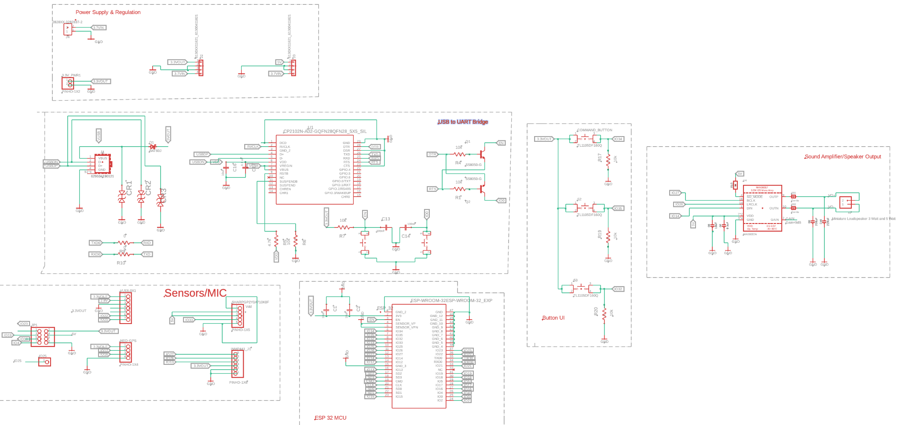
PCB (MCU Layout Schematic )

Slide 25
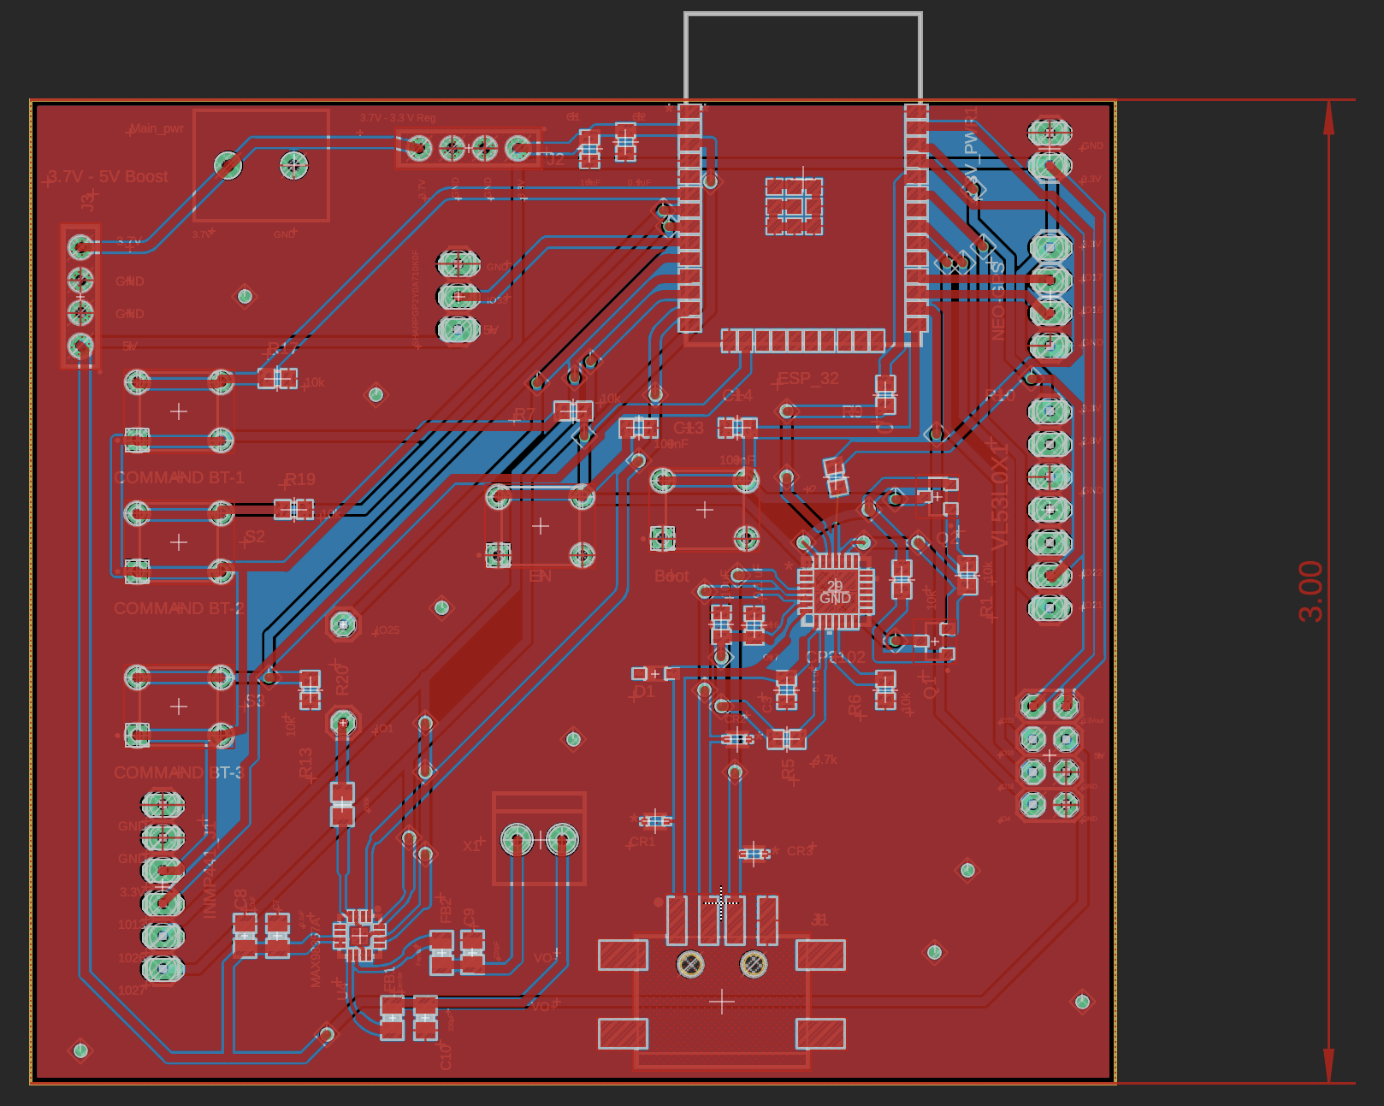
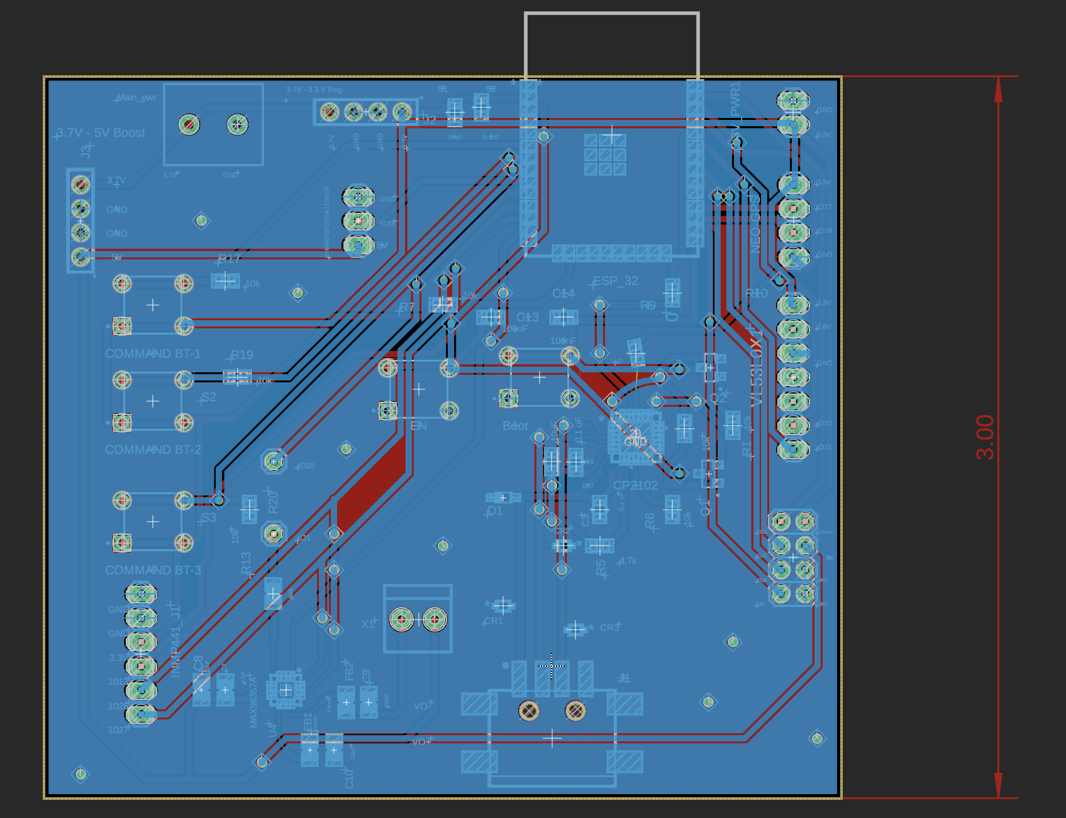
PCB (MCU Layout)

Slide 26
PCB (MCU Layout)
Main Components:
  ESP 32 wroom module (Top Right)
  Max98357a Sound amplification Unit (Bottom Left)
  USB - UART Unit (Middle Right)
  User Buttons with 10k Ohm pull down resistors (Middle Left)
  Male/Female pin headers for various sensors and Battery Regulation (Edges of the PCB)

Slide 27

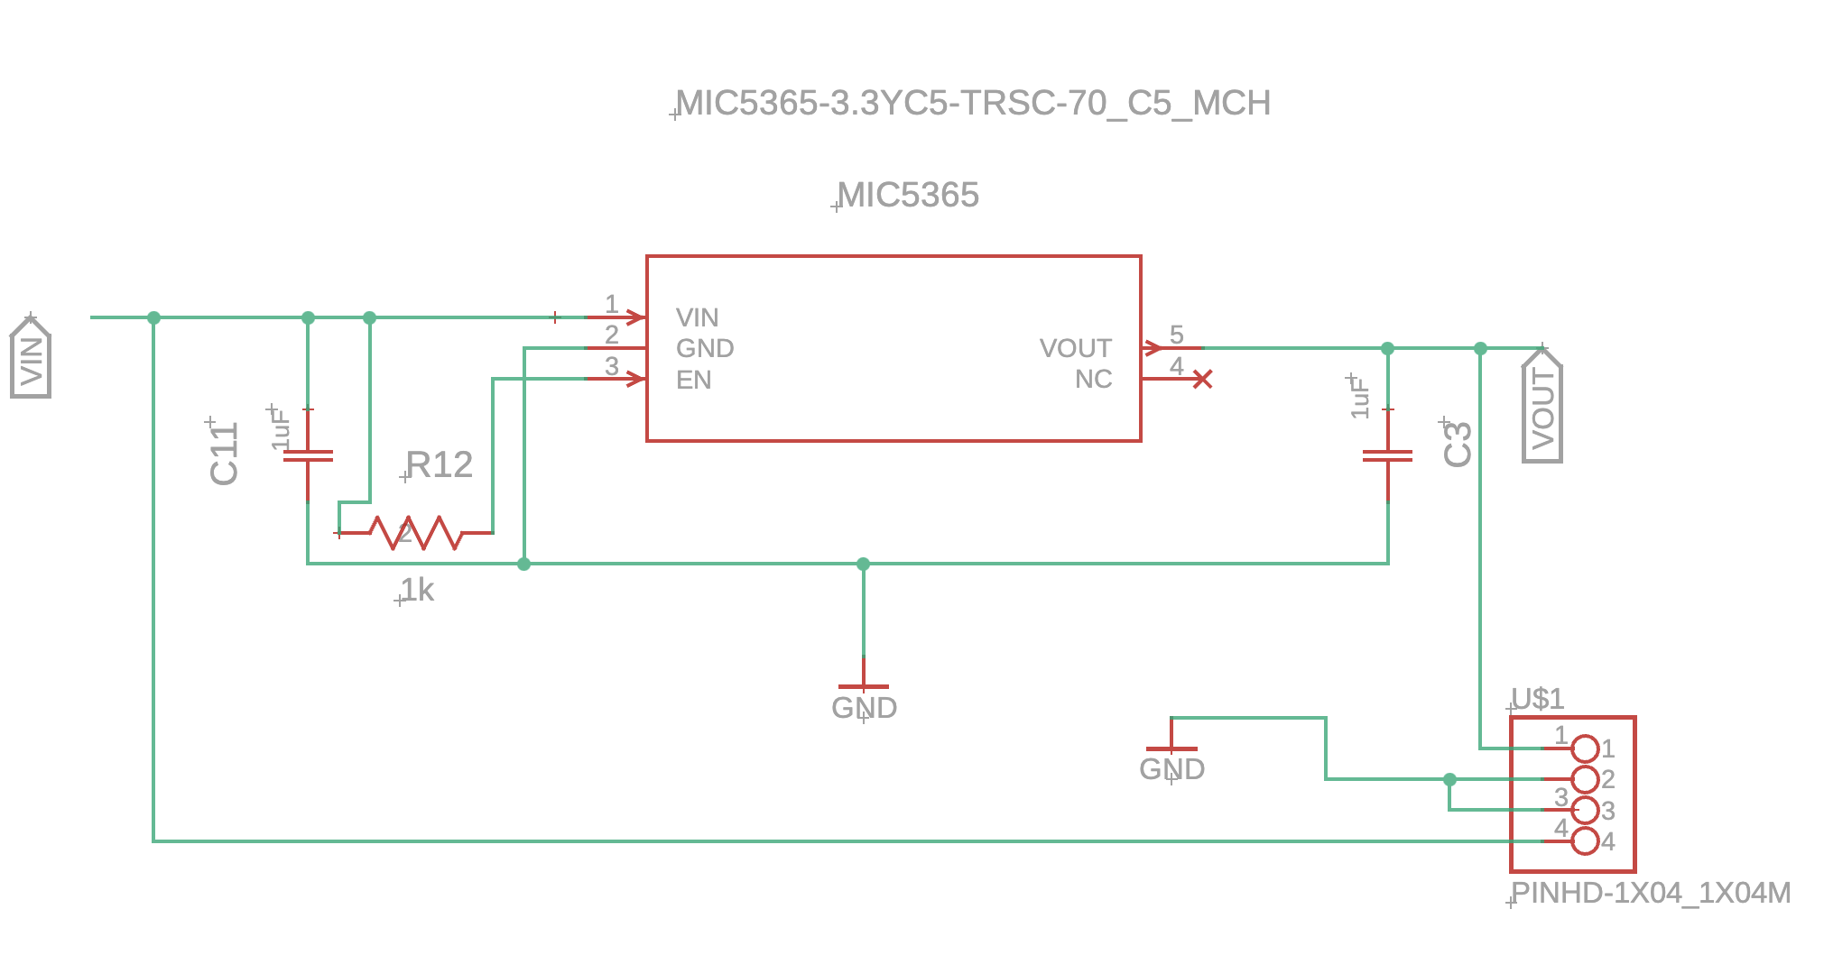
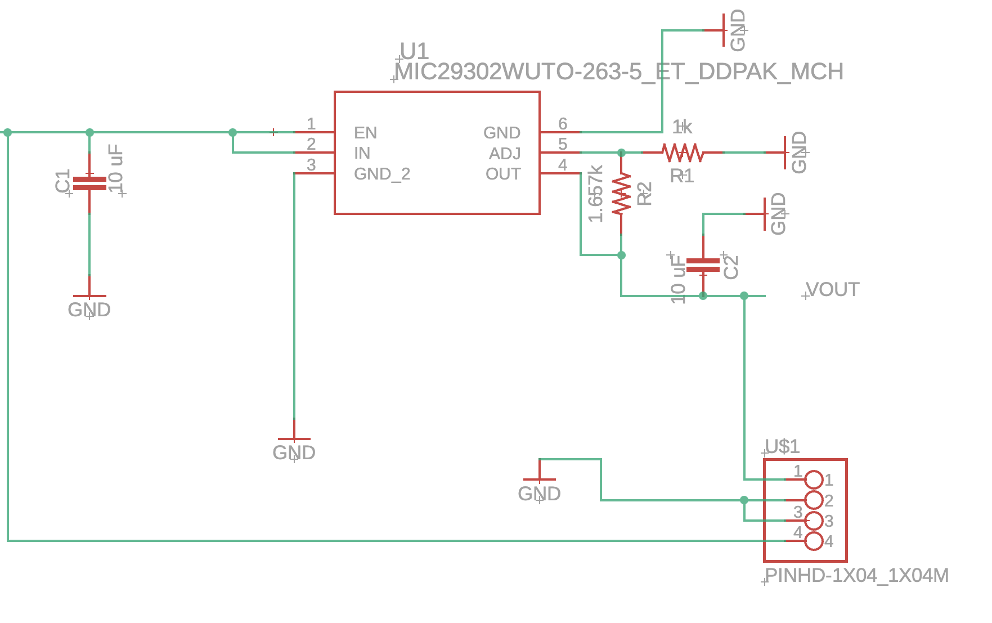
PCB (3.3 V Reg #1&2 Schematics )

Slide 28
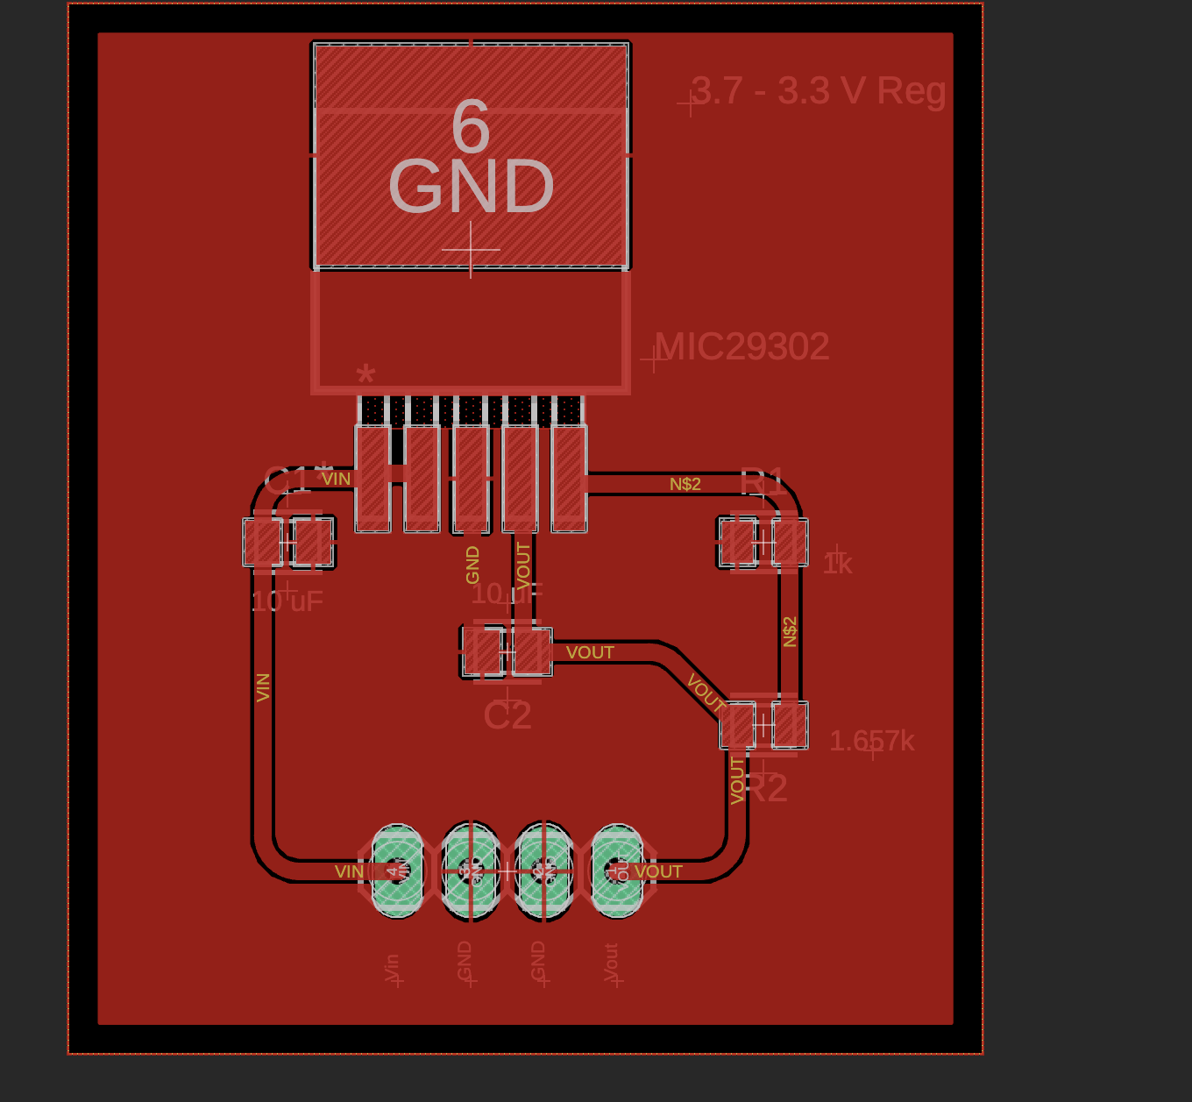
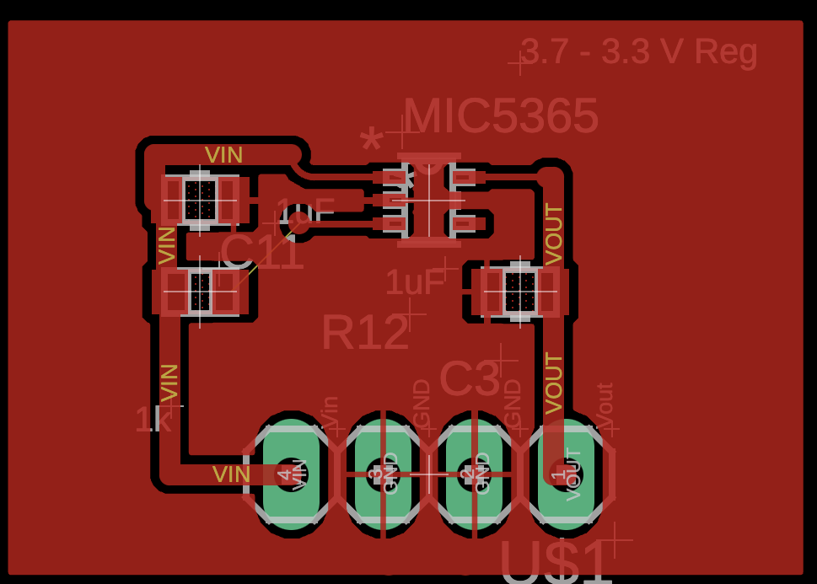
PCB (3.3 V Reg #1 & 2)

Slide 29
PCB (3.3 V Reg #1)
Main Components:
  MIC5365-3.3 Chip
  1µF ceramic output capacitors
  1k EN Resistor and 4 head Pin header

Slide 30
PCB (3.3 V Reg #2)
Main Components:
  MIC29302A-3.3 Chip
  Adjustable output set by two external resistors (R1/R2)
  Two 10uF Ceramic Capacitors

Slide 31
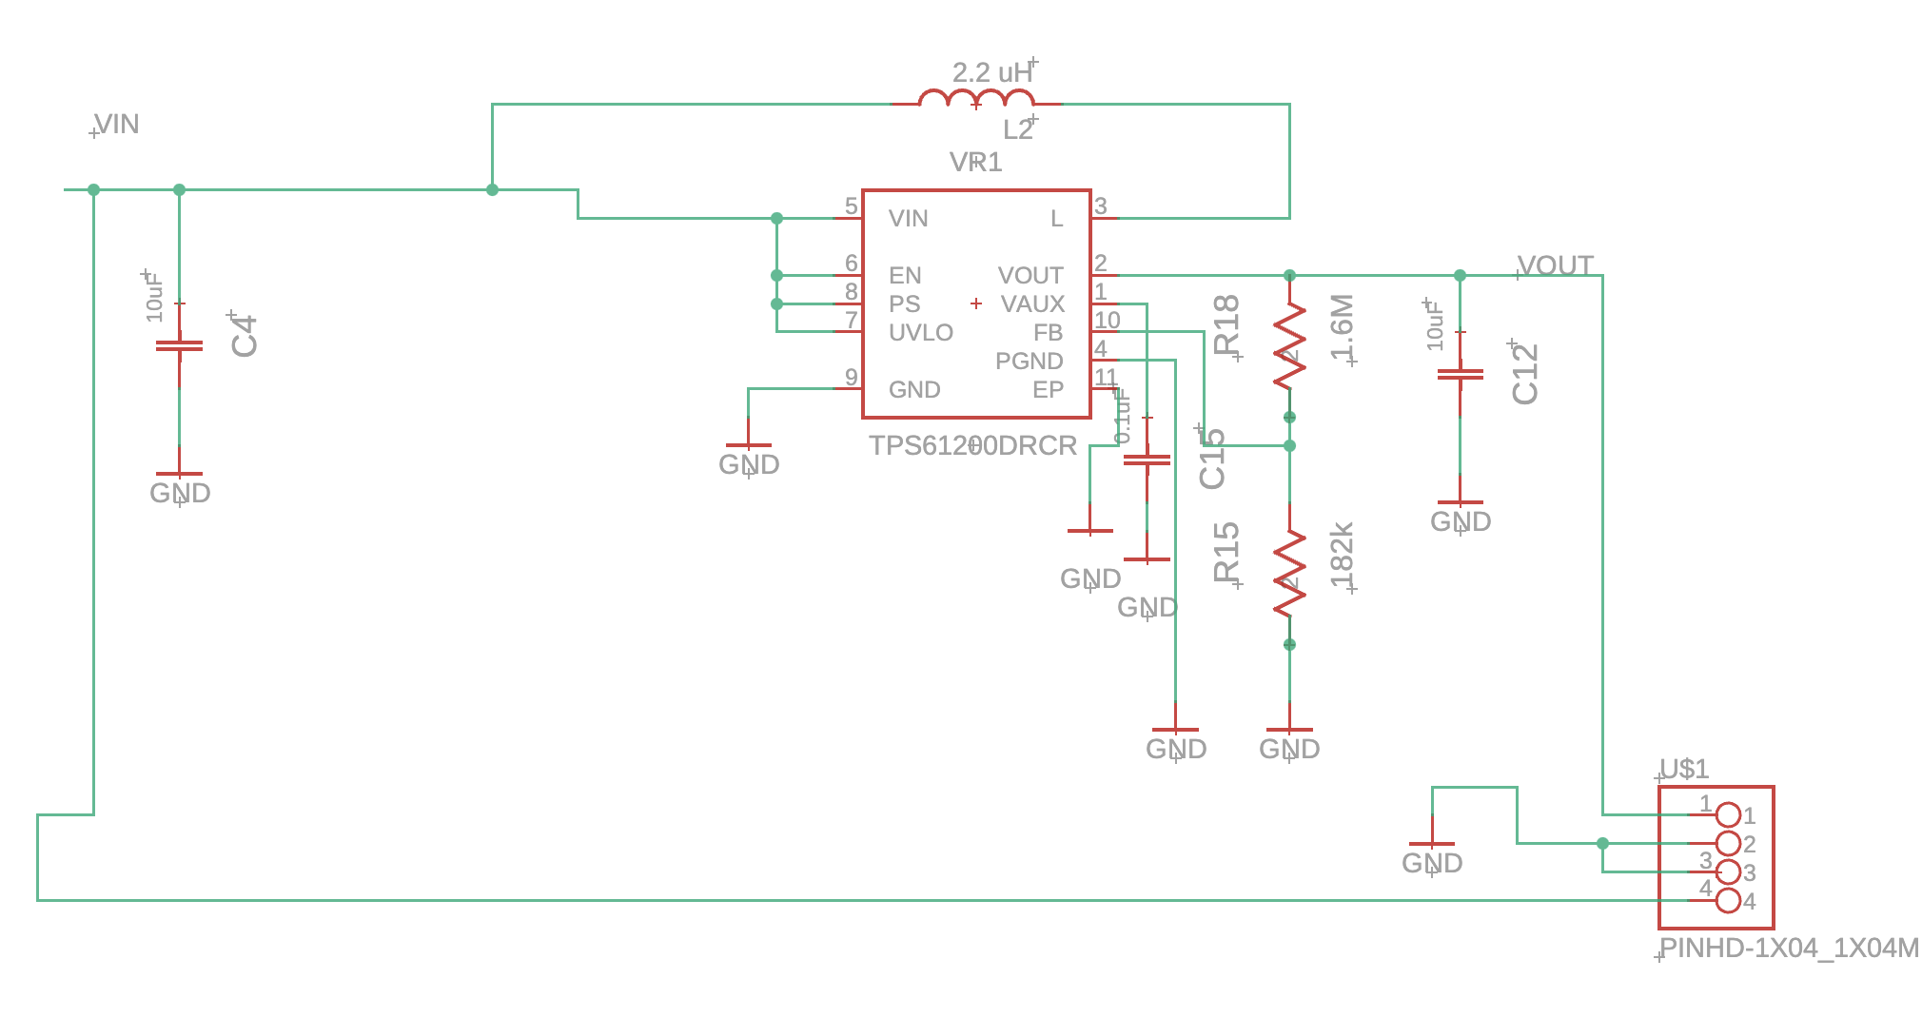
PCB (TPS 3.7 - 5V Boost Schematic )

Slide 32
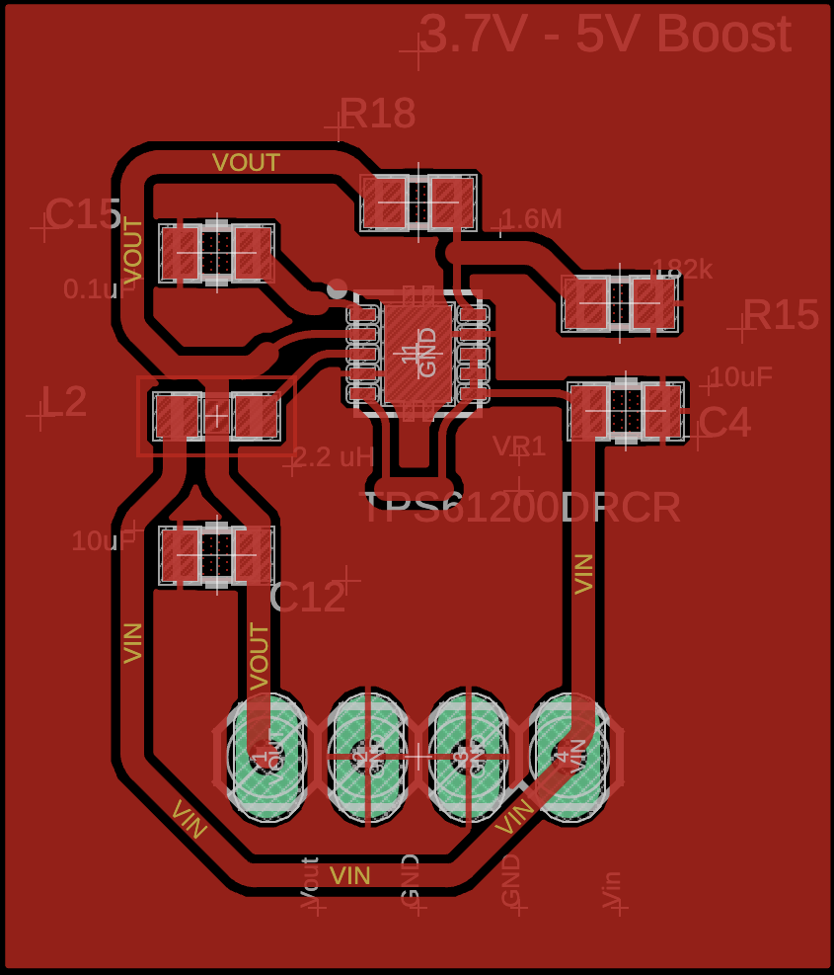
PCB (TPS 3.7 - 5V Boost )
Main Components:
  TPS61200 Boost Convertor
  2.2 uH inductor
  Two 10uF Ceramic Capacitors and one 0.1uF capacitor
  Resistor divider to program output voltage

Slide 33
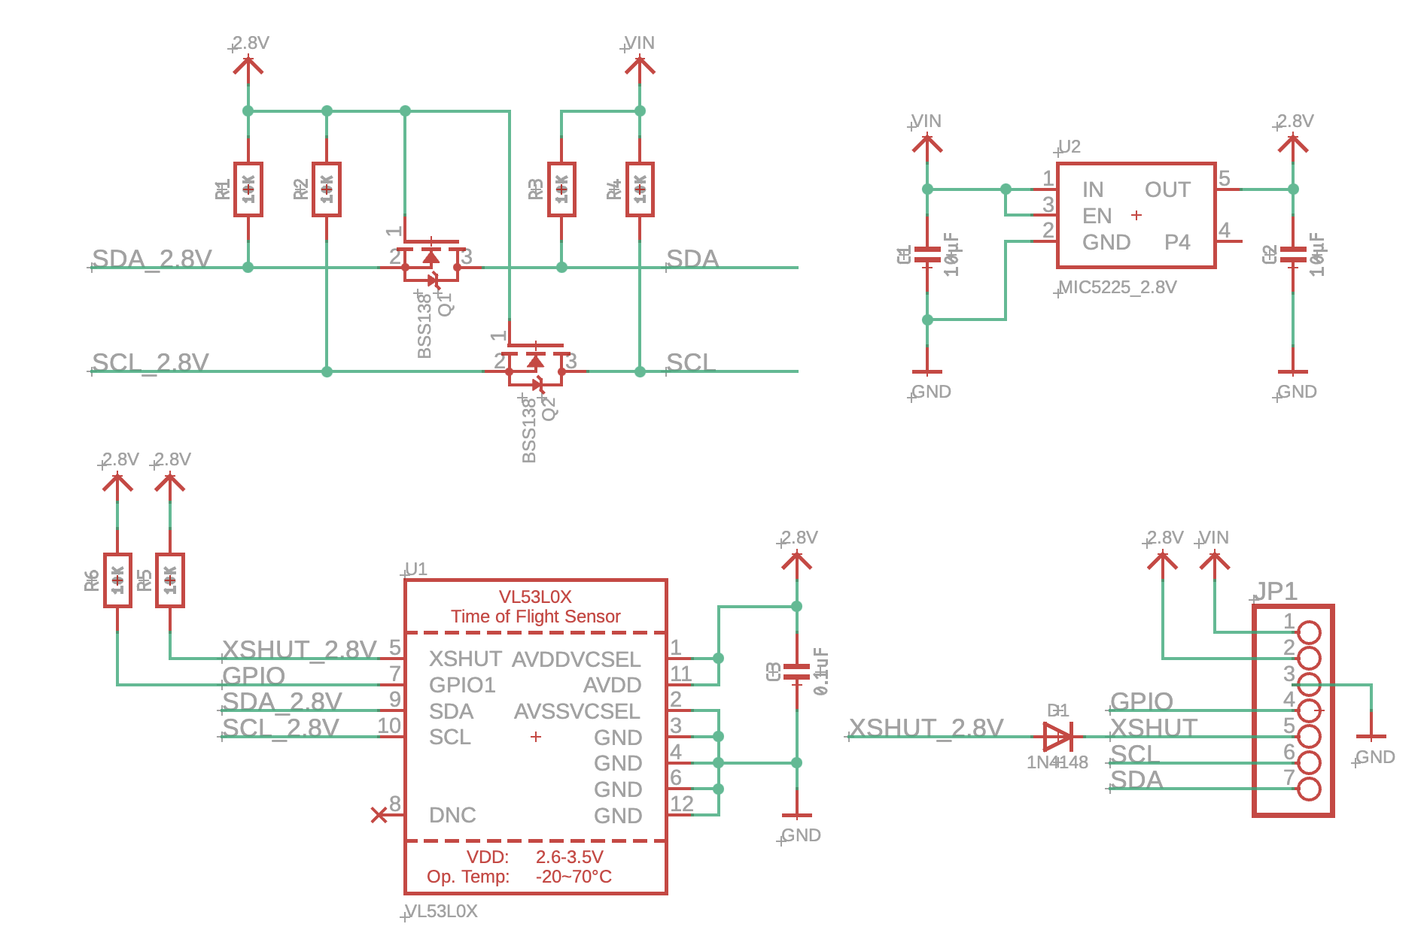
PCB (VL53L1X Sensor Schematic)

Slide 34
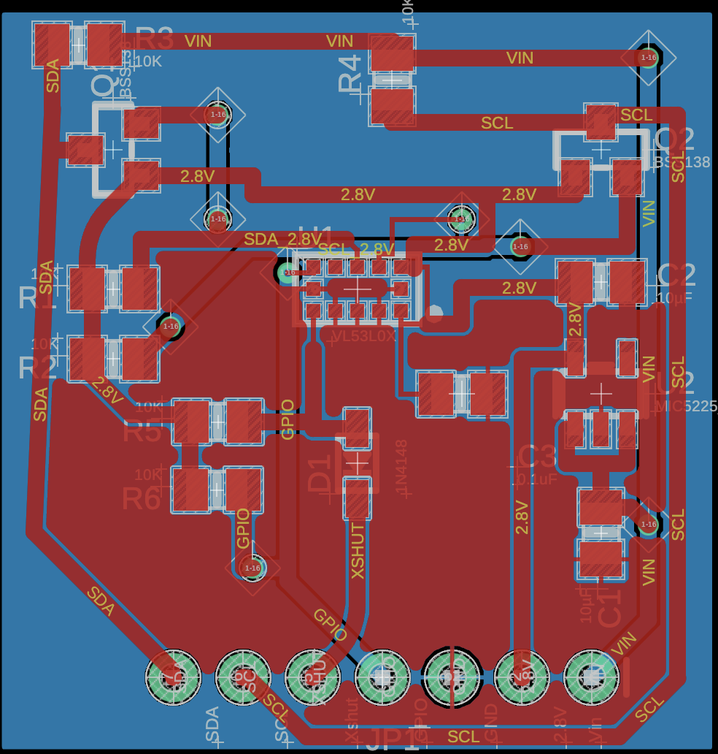
PCB (VL53L1X Sensor)
Main Components:
  VL53L1X Time of Flight Sensor
  MIC5225_2.8V Regulator
  BSS138 Transistor (level shifting)
  10K pull up resistors
  10uF capacitors

Slide 35
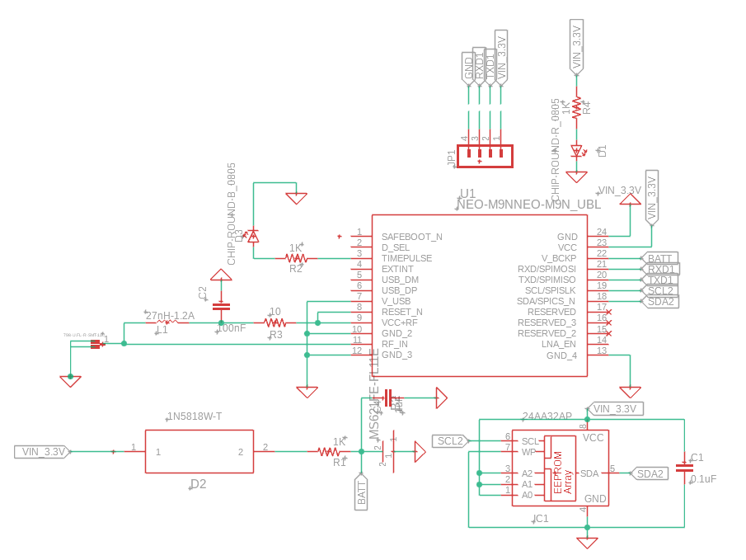
PCB (GPS Module Schematic)

Slide 36
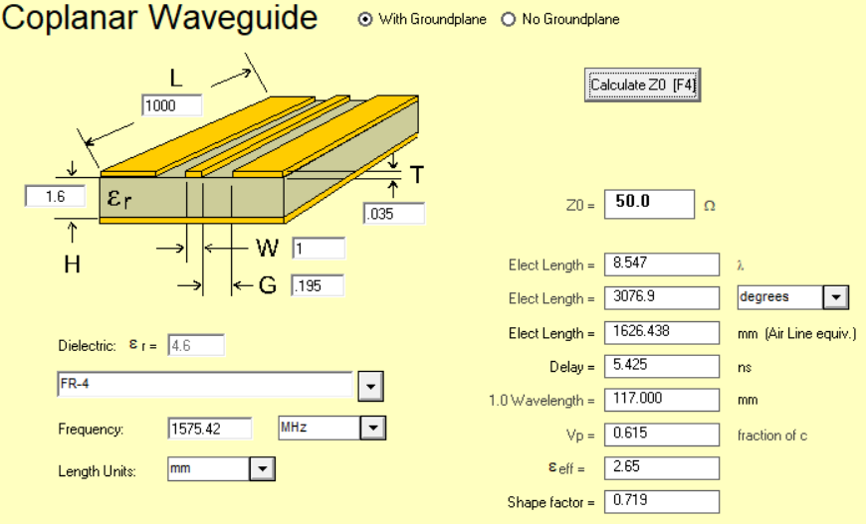
GPS Module Design Considerations
AppCad

Slide 37
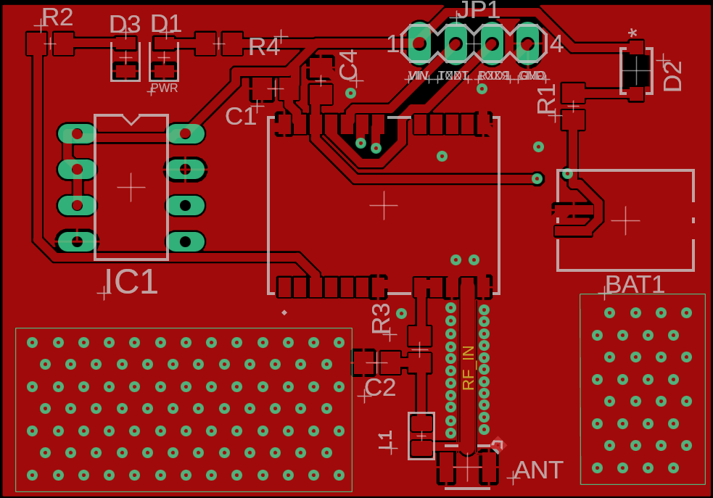
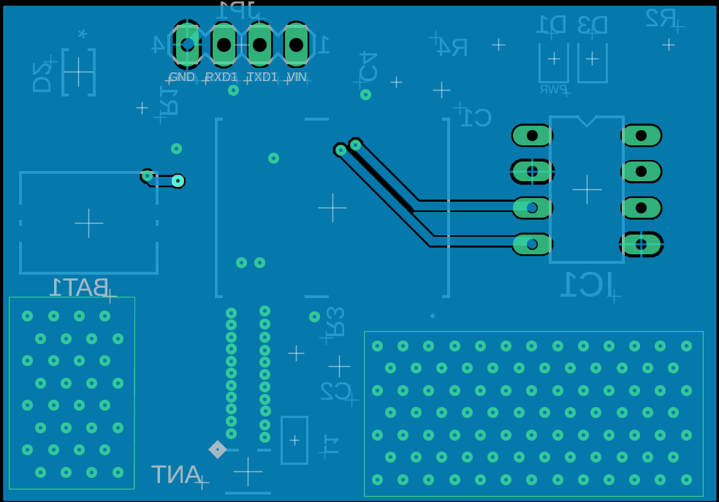
PCB (GPS Module)

Slide 38
PCB (GPS Module)
Main Components:
  Neo-M9N GPS module
  Cirocomm Active GPS antenna
  24AA32A/P EEPROM
  MS621FE-FL11E backup battery
  Status LEDs
  Resistors
  Bypass/input capacitors

Slide 39
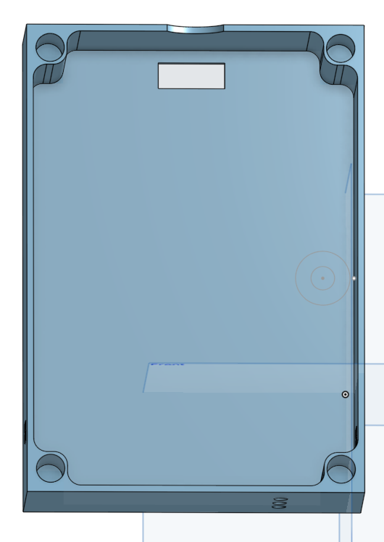
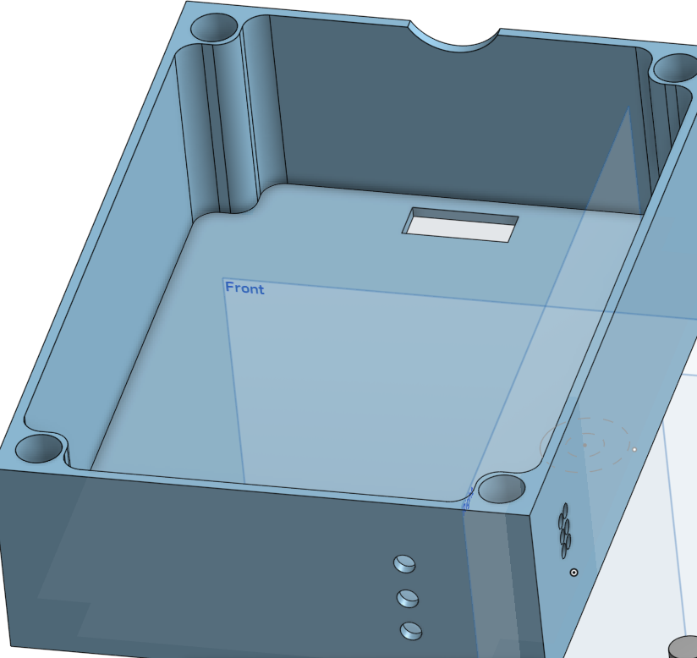
Single 3D-printed enclosure housing all SmartNav components
Top-mounted sensors and microphone integrated into the lid
Dedicated ports for audio output and power connections
Modular compartments for PCBs and power supply for precise fit
Fully protects all electronics within a unified housing
3D-Printed Housing Design Concept

Slide 40
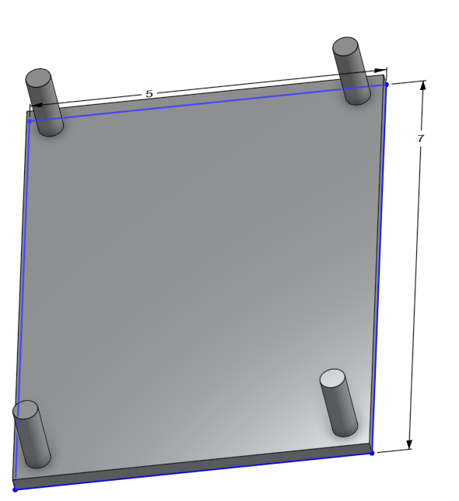
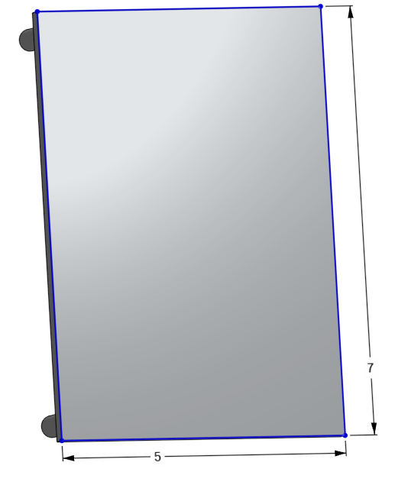
3D-Printed Housing Design Concept (Top Sensor Housing Cover)
This is the design for our cover that we will enclose on our housing.
We created it in a way to have easy access to all our PCBs as well as our battery.

Slide 41
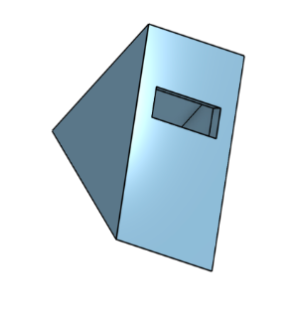

3D-Printed Housing Design Concept (Bottom Sensor Housing)
Triangular mount angles the ToF beam parallel to the ground.
Low‑profile housing fits flush at the cane tip for impact protection..

Slide 42
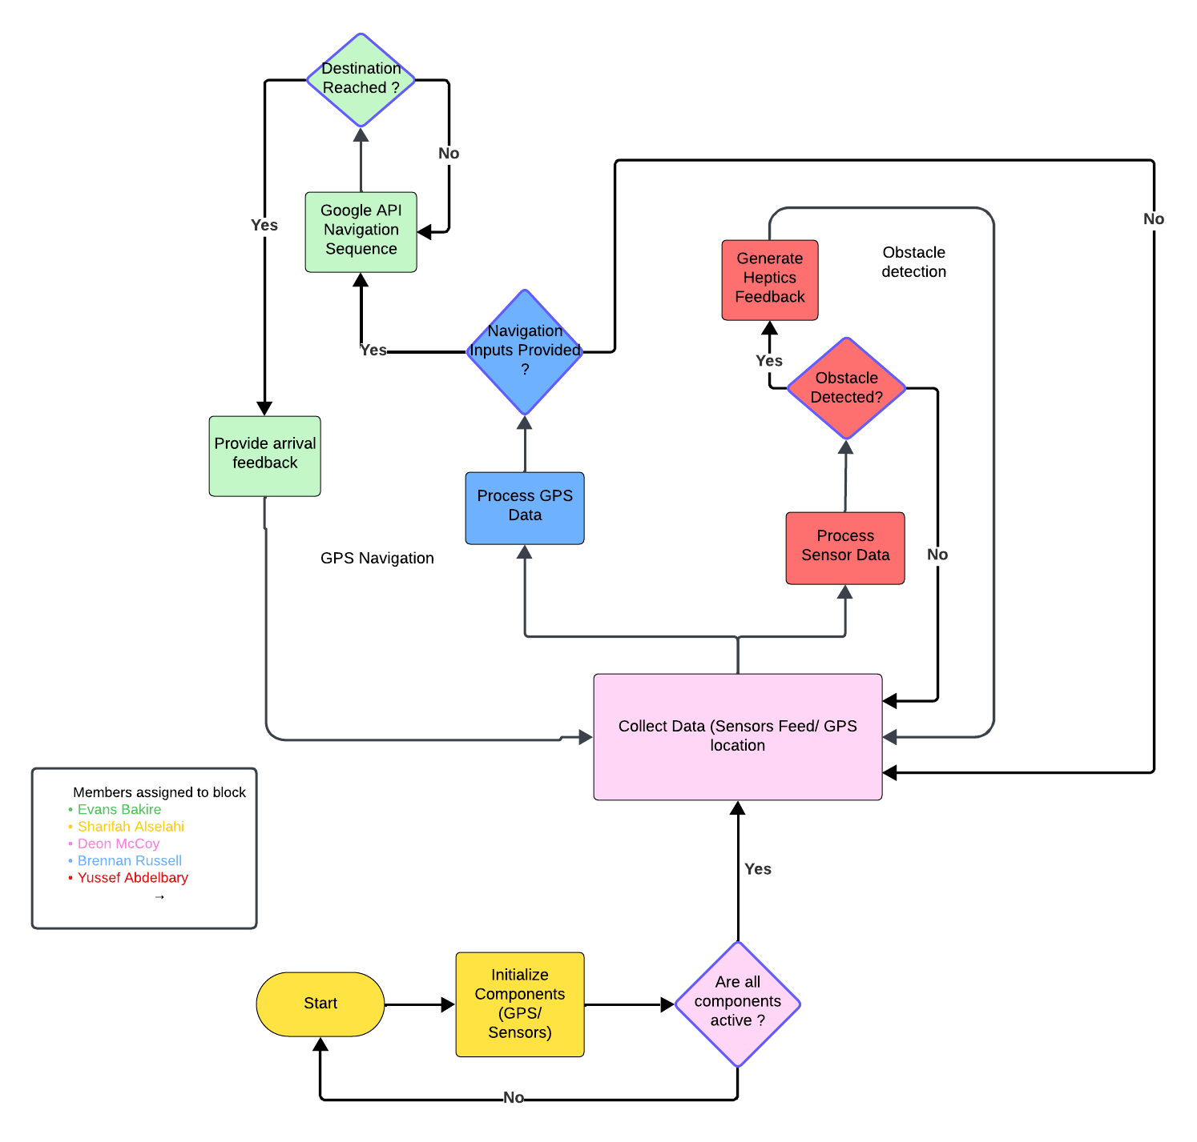
Software Flow
Chart

Slide 43
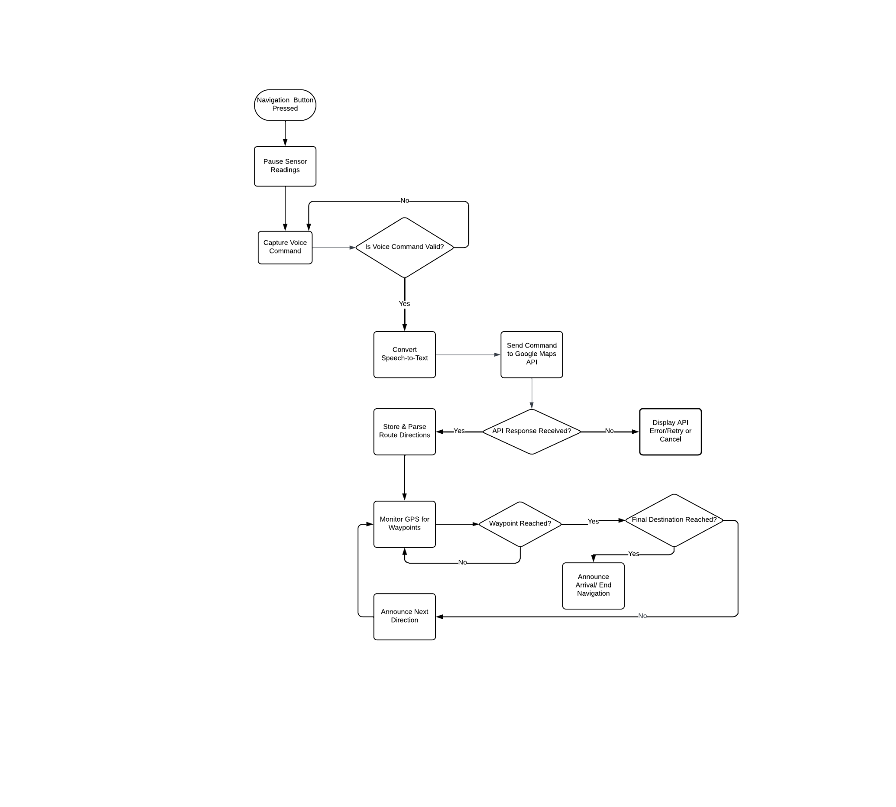
Navigation System
Flowchart

Slide 44
Software Design (API)
Navigation API
  Google Maps Directions API ( Widely used, high coverage and accuracy Simple JSON “steps” output.Familiar SDKs )
Speech-to-Text
  Google Cloud Speech-to-Text ( Best accuracy for English walking commands, Streaming & batch modes, Consistent API family)
Text to Speech
  Google Text to Speech (ext-to-Speech , Streams audio in small chunks, fitting within our buffer constraints, Avoids large base64JSON, We will use esp 32 mp3 decoder library to decode the tts feedback data)

Slide 45
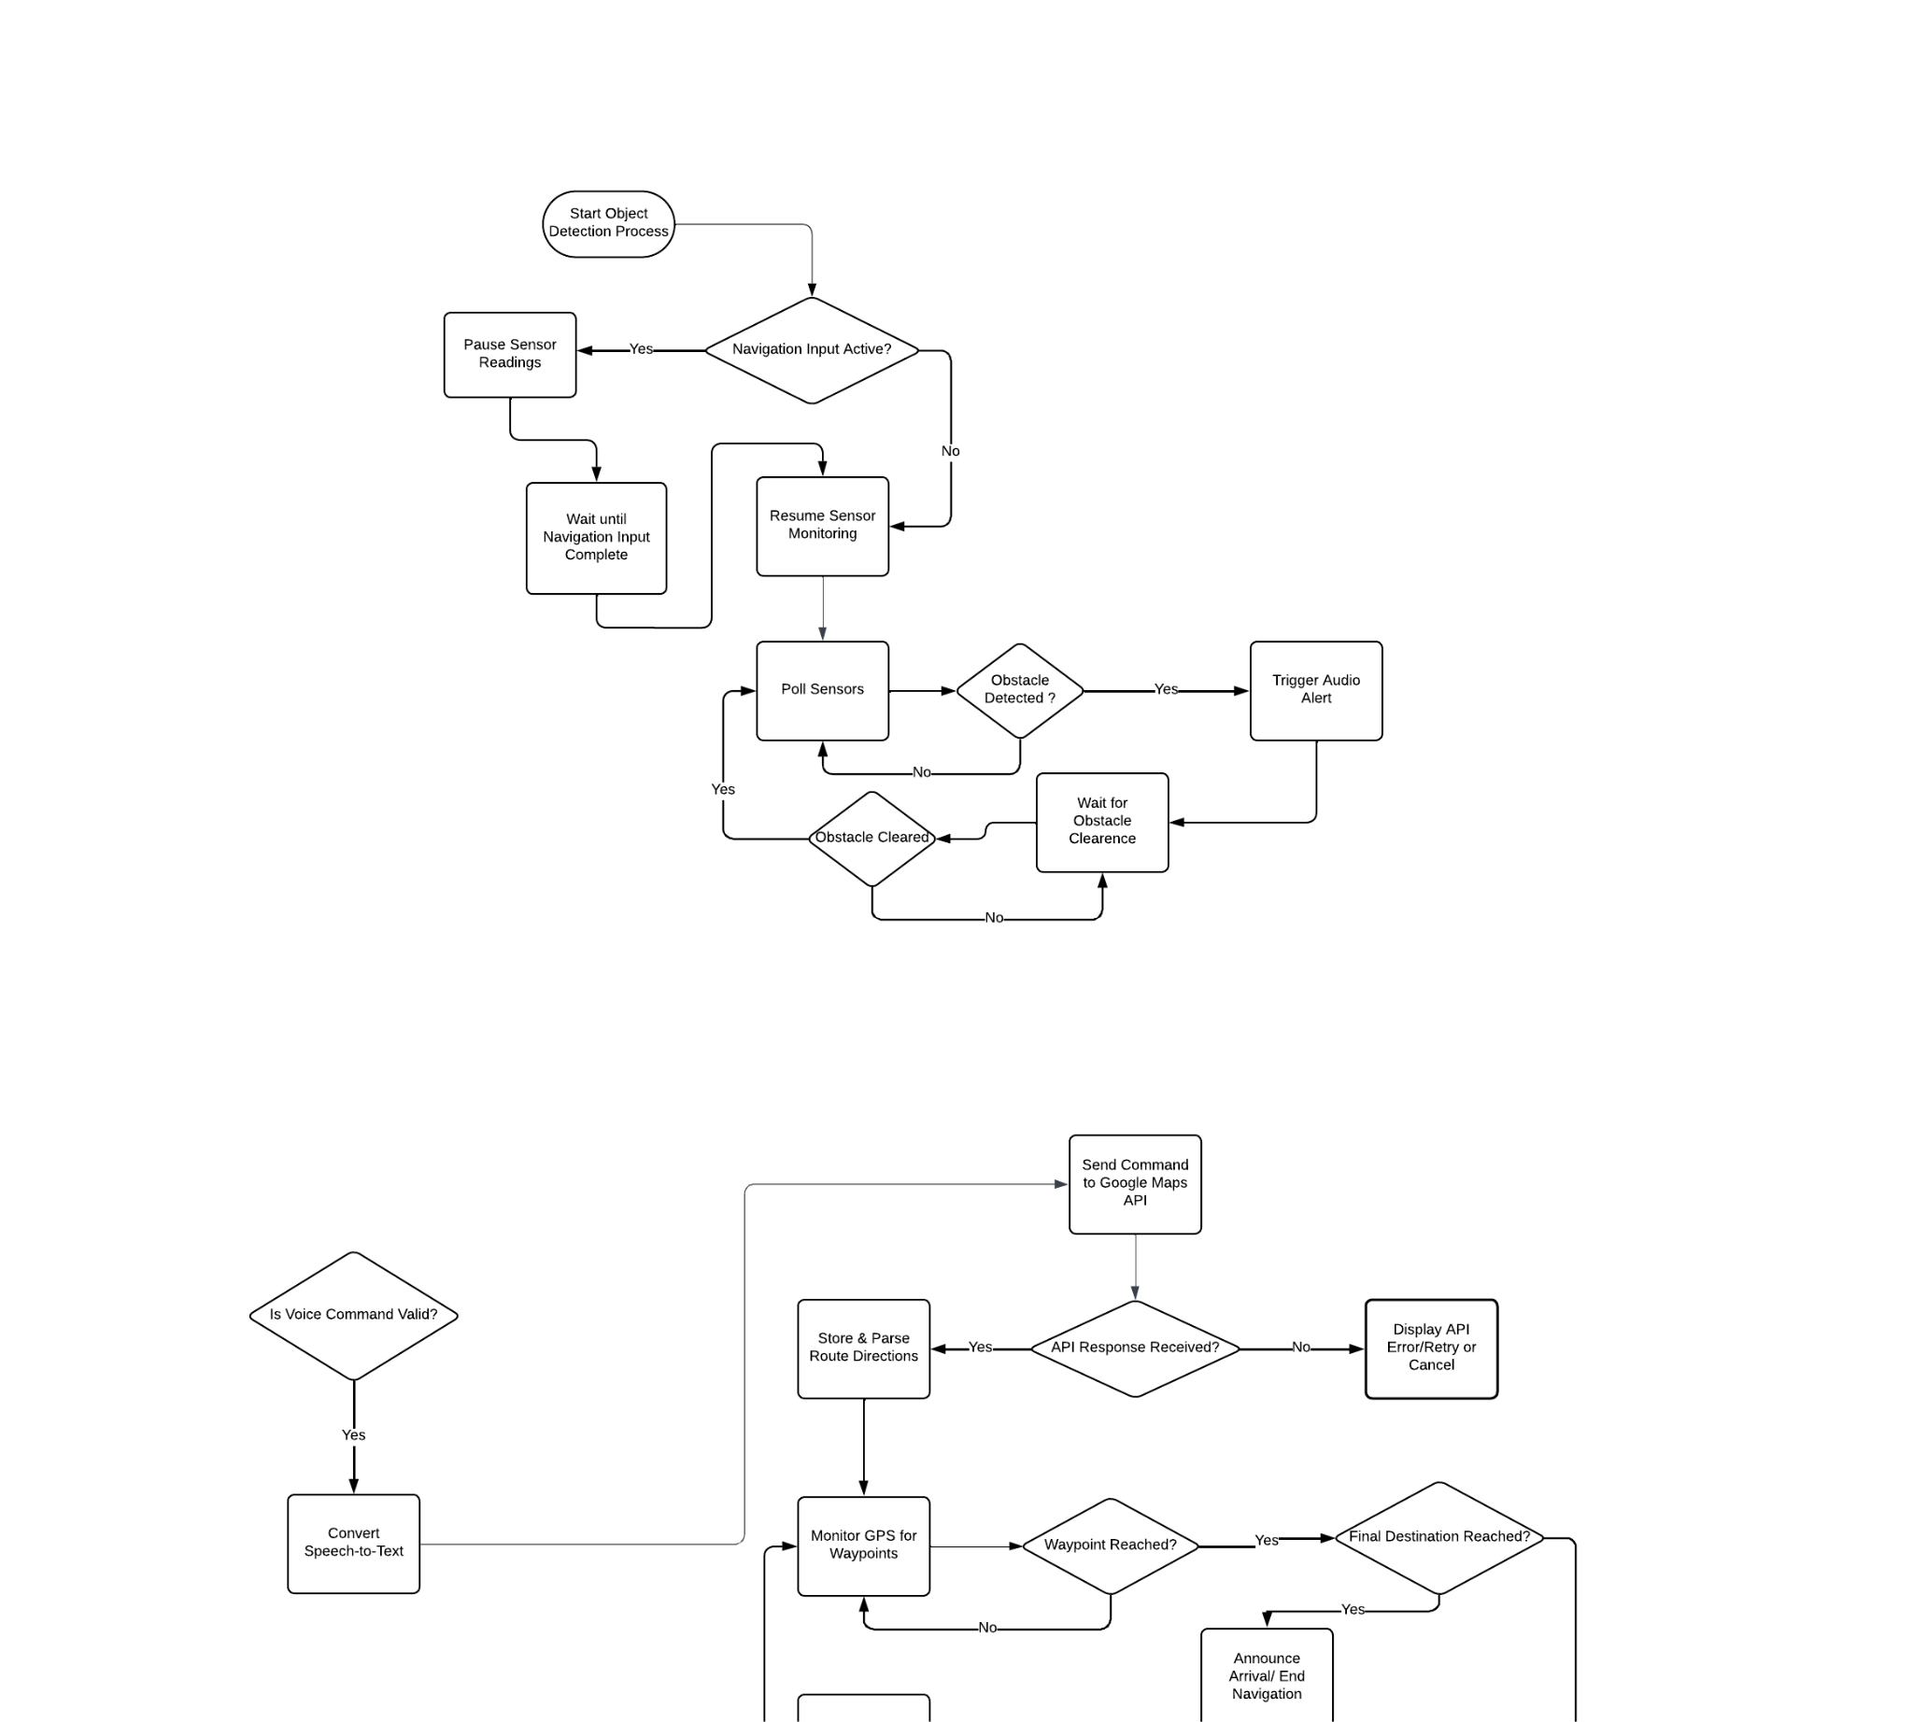
Object Detection System
Flowchart

Slide 46
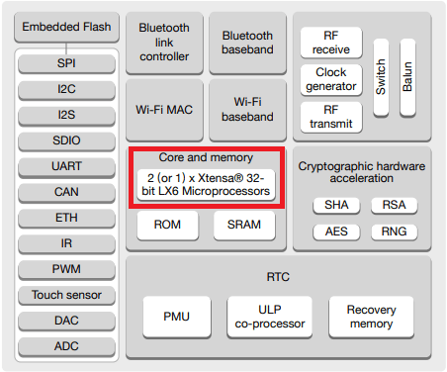
Software Design (ESP 32 Dual core )
Core 0: Dedicated Heavy Synthesis Task: Offloads the most demanding background process (TTS) and SD card writes.
Core 1: Main Application & Real-Time Tasks: Runs navigation logic, sensor polling, STT requests, I2S Mutex and Battery Analysis
Enhanced System Responsiveness: Ensured real-time sensor feedback was never delayed due to parallelism.
Reduces API system Latency

Slide 47
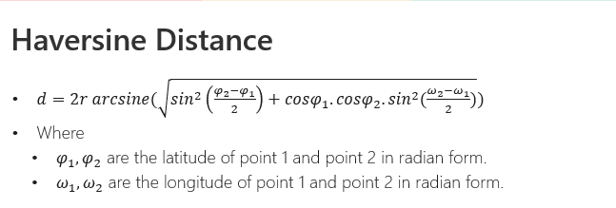
Software Design (Way point Distance)
Treat each waypoint’s latitude/longitude as points on a sphere and apply the Haversine formula to compute their distance.
Use that calculated distance to determine proximity, compare waypoints, or trigger navigation events when the user approaches a waypoint.
If d ≤ 10 m (Play zone): Play the pre‐loaded “turn now” audio so it’s heard exactly when the user reaches the waypoint.
Simultaneously pre-fetch the audio for the next waypoint in the background while still navigating to eliminate download delays.

Slide 48
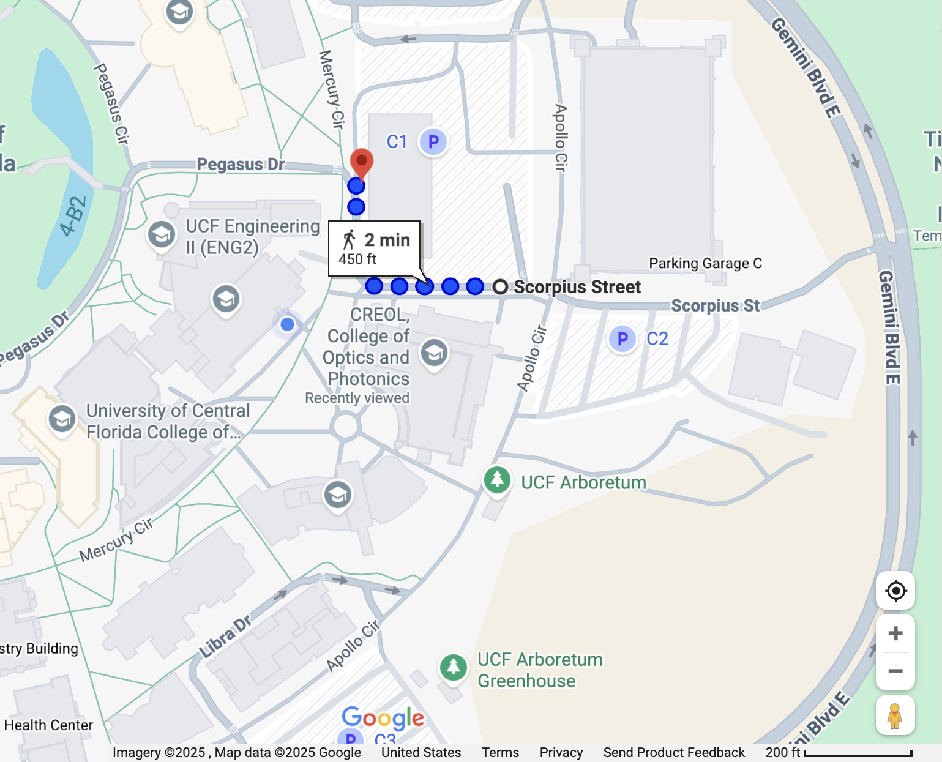
Software Design (Off Route Detection )
Detects if the user is consistently moving away from the next waypoint.
Uses a counter to confirm the off-route trend, ignoring minor GPS jitter.
Reroutes automatically by fetching a new path from the user's live location.

Slide 49
Development Environment Comparisons
 | Arduino-IDE | PlatformIO | ESP-IDF
Language Support | C/C++ | C/C++, Python | C/C++, Python, Rust
Board Support | Arduino and ESP32 | Various platforms and frameworks | ESP framework
Debugging | Limited(serial monitor) | Advanced(JTAG, GDB) | FULL
Compiler | Moderate | Moderate | Optimized
Use case | Beginners/ user-friendly | Intermediate, advanced features | Experts/steep learning curve/performance-critical apps
User Friendly
Existing Libraries
Large Community

Slide 50
Communication Protocols
UART (Universal Asynchronous Receiver/Transmitter)
  We use UART to communicate with the NEO-M9N GPS module, which continuously sends serial data such as
location, speed, and time. UART allows for reliable, point-to-point communication between the GPS and the ESP32.
I2C (Inter-Integrated Circuit)
  The VL53L1X time-of-flight distance sensor is connected via I2C. two-wire protocol (SDA and SCL) well-suited for short-distance, multi-device communication.
SPI (Serial Peripheral Interface)
  The SD card module communicates via SPI and is used to write and store microphone recordings and waypoint audio prompts for our navigation system
ADC (Analog-to-Digital Converter)
  The ESP32’s internal ADC is used to read analog signals from the Sharp IR distance sensor and the battery voltage divider circuit.
I2S (Integrated Inter-IC Sound)
  We use the I2S protocol to handle digital audio. It receives input from a MEMS microphone and outputs audio to the MAX98357A amplifier and speaker, enabling real-time sound feedback and voice-based interaction in our system.

Slide 51
Prototyping and Testing
API Functionality Verification:
  Test HTTP requests to (STT/TTS) and Google Directions endpoints from prototype
Hardware Validation:
  Prototyped ESP32, INMP441 microphone STT, MAX98357A amplifier Beeps +TTS Audio, and SD card module writes
  Measured signal-to-noise ratio and intelligibility in typical environment
Sensor Integration Tests:
  Confirmed accurate GPS module coordinate acquisitions with minimal deviation from polyline
  Tested sensors for object detection up to specified threshold.

Slide 52
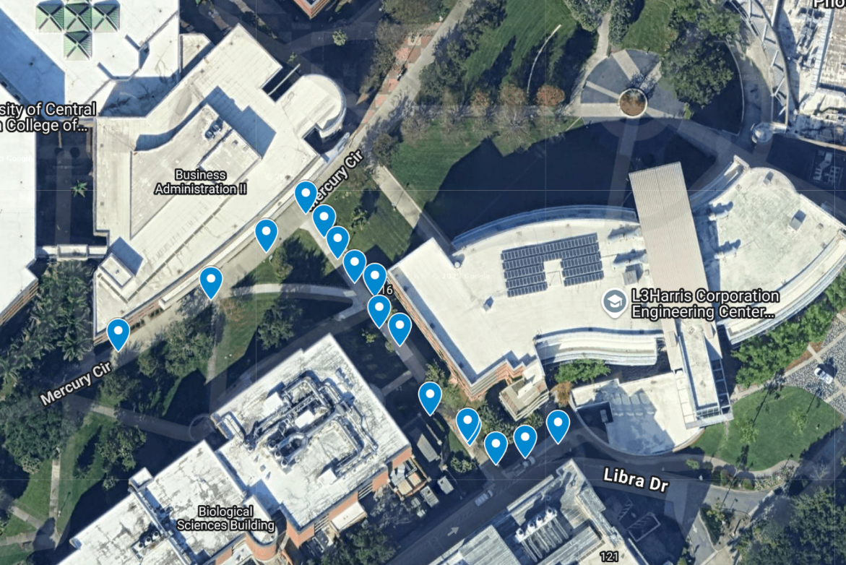
GPS Coordinates Accuracy Testing
  We performed a real-world walking tests to see how accurately the device could map a path in real-time. (eg Business Admin Building to HEC Building)
  When we plotted the logged GPS data, the recorded track very closely followed the actual sidewalk on the satellite map
  There was some minor, expected GPS "jitter," due to trees and buildings
  This result confirms our GPS module is highly reliable for providing accurate, turn-by-turn navigation.

Slide 53
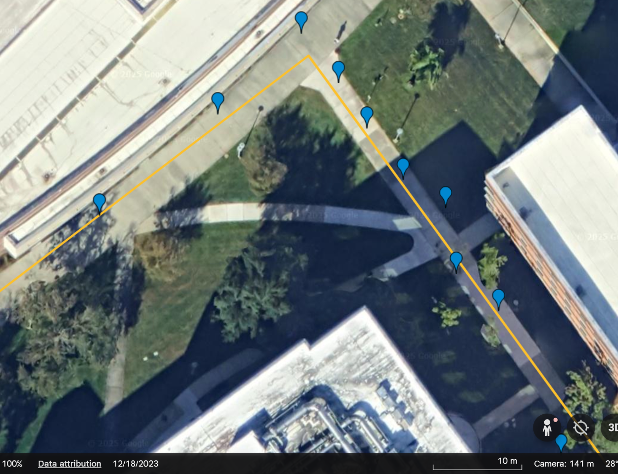
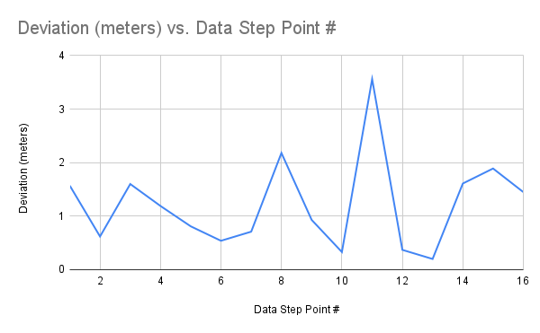
GPS Coordinates Accuracy Testing
  Our device's recorded path stayed very close to the actual path polyline we walked, which is shown by the yellow line, average = 1.2223 m.
  There was one spot where the path briefly immense (3+ meters) away from the polyline. This happened right when we walked under a tree that blocked the signal.

Slide 54
Navigation Accuracy Testing
  O
Test # | Input location | Expected Command | Actual Output | Correct
1 | UCF Campus | “Head East Towards Mercury Cir” | “Head East Towards Mercury Cir” | Yes
2 | UCF Campus | “Turn left onto mercury cir” | “Turn left onto mercury cir” | Yes
3 | UCF Campus | “Turn left onto pegasus dr” | “Turn left onto pegasus dr” | Yes
4 | UCF Campus | “Turn right onto pegasus dr” | “Turn right onto pegasus dr” | Yes
5 | UCF Campus | “Turn right” | “Turn right” | Yes
6 | UCF Campus | “You have arrived” | “You have arrived” | Yes

Slide 55
Object Detection Accuracy Testing
Test # | Object | Detected during Day | Detected during Night
1 | Box | Yes | Yes
2 | Bench | Yes | Yes
3 | Tree | Yes | Yes
4 | Fire Hydrant | Yes | Yes
5 | Chair | Yes | Yes
6 | Curb | Yes | Yes
7 | Door | Yes | Yes
8 | Car | Yes | Yes
9 | Bag | Yes | Yes
10 | Trashcan | Yes | Yes

Slide 56
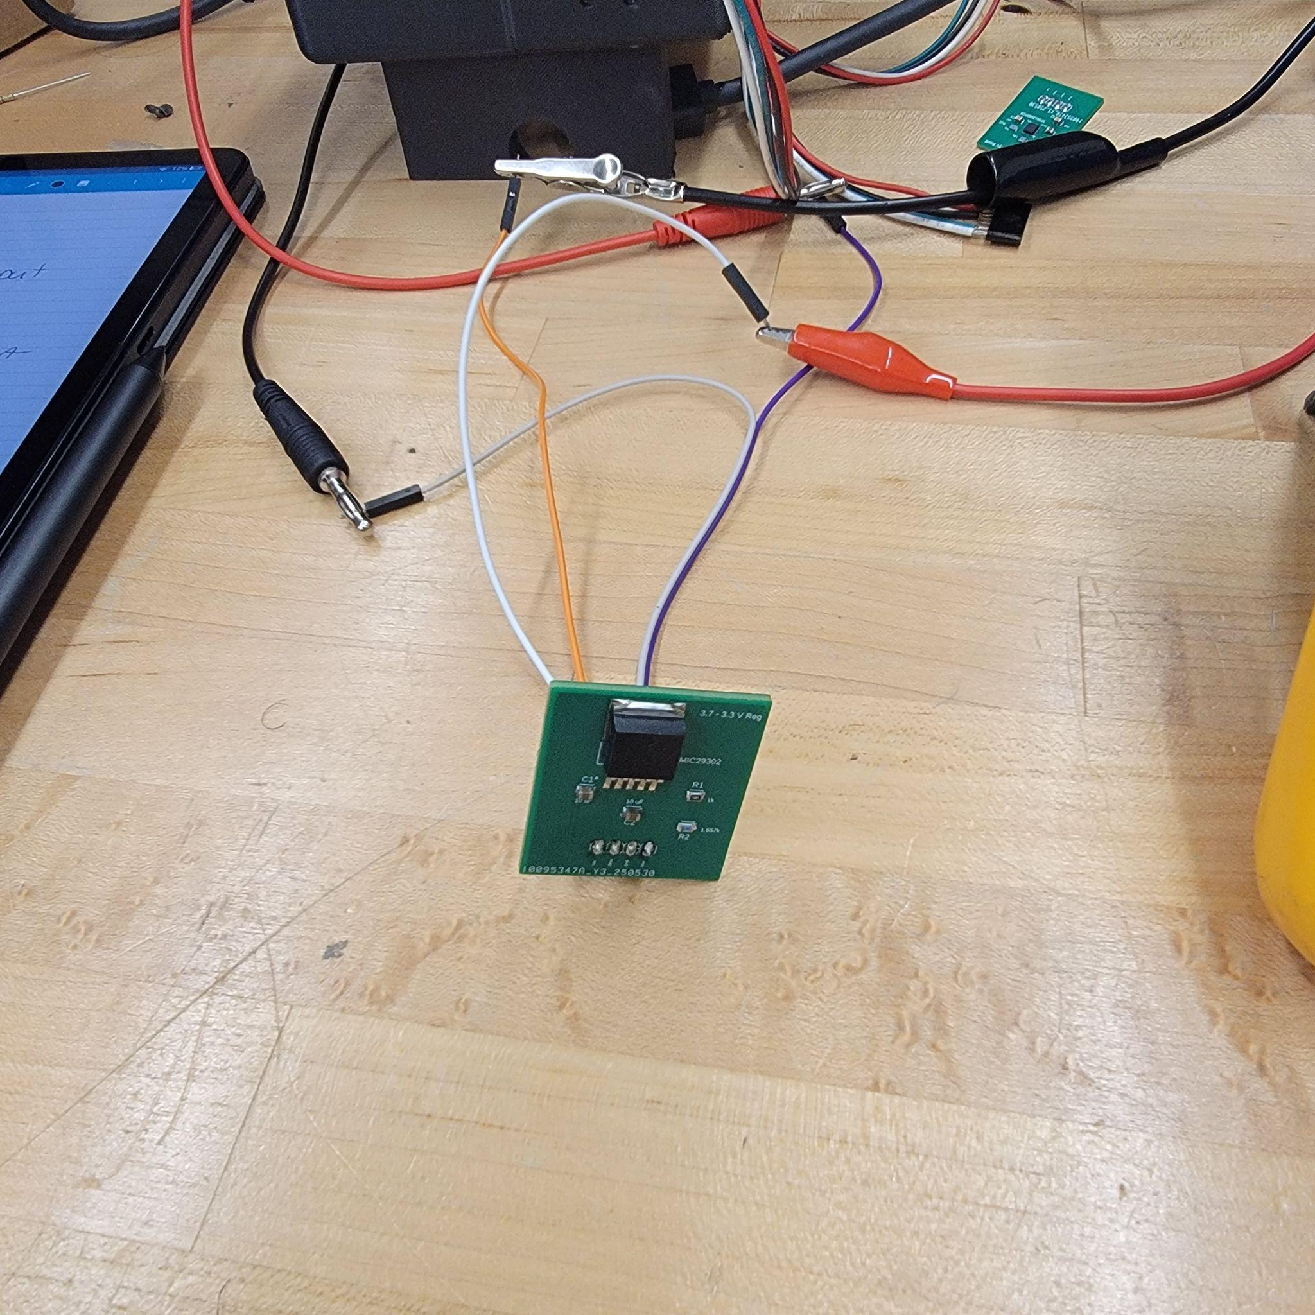
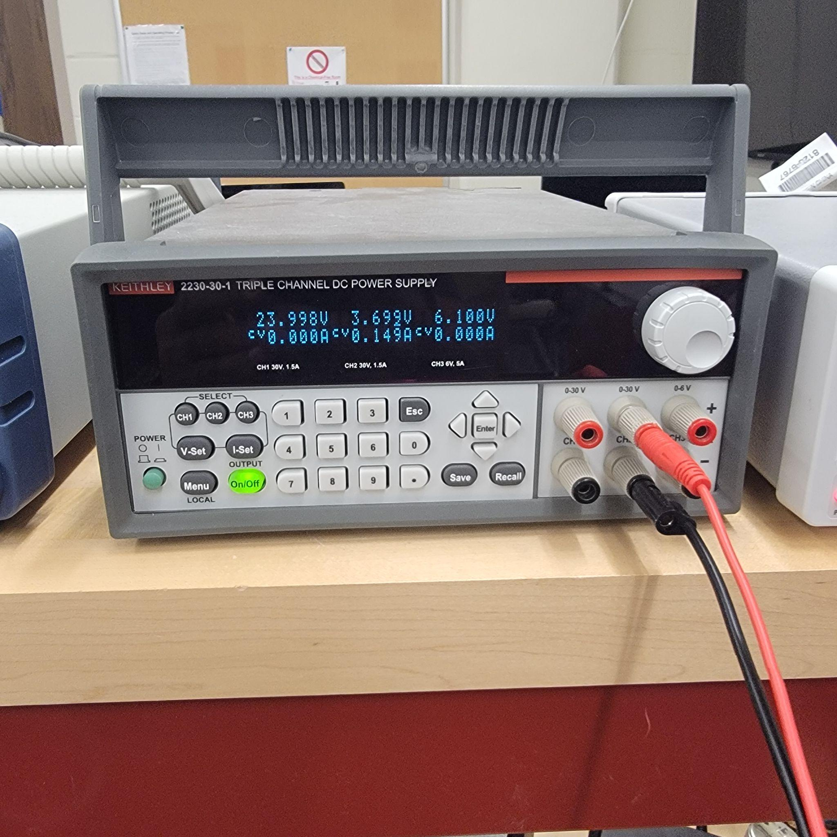
Voltage Regulator Load Testing

Slide 57
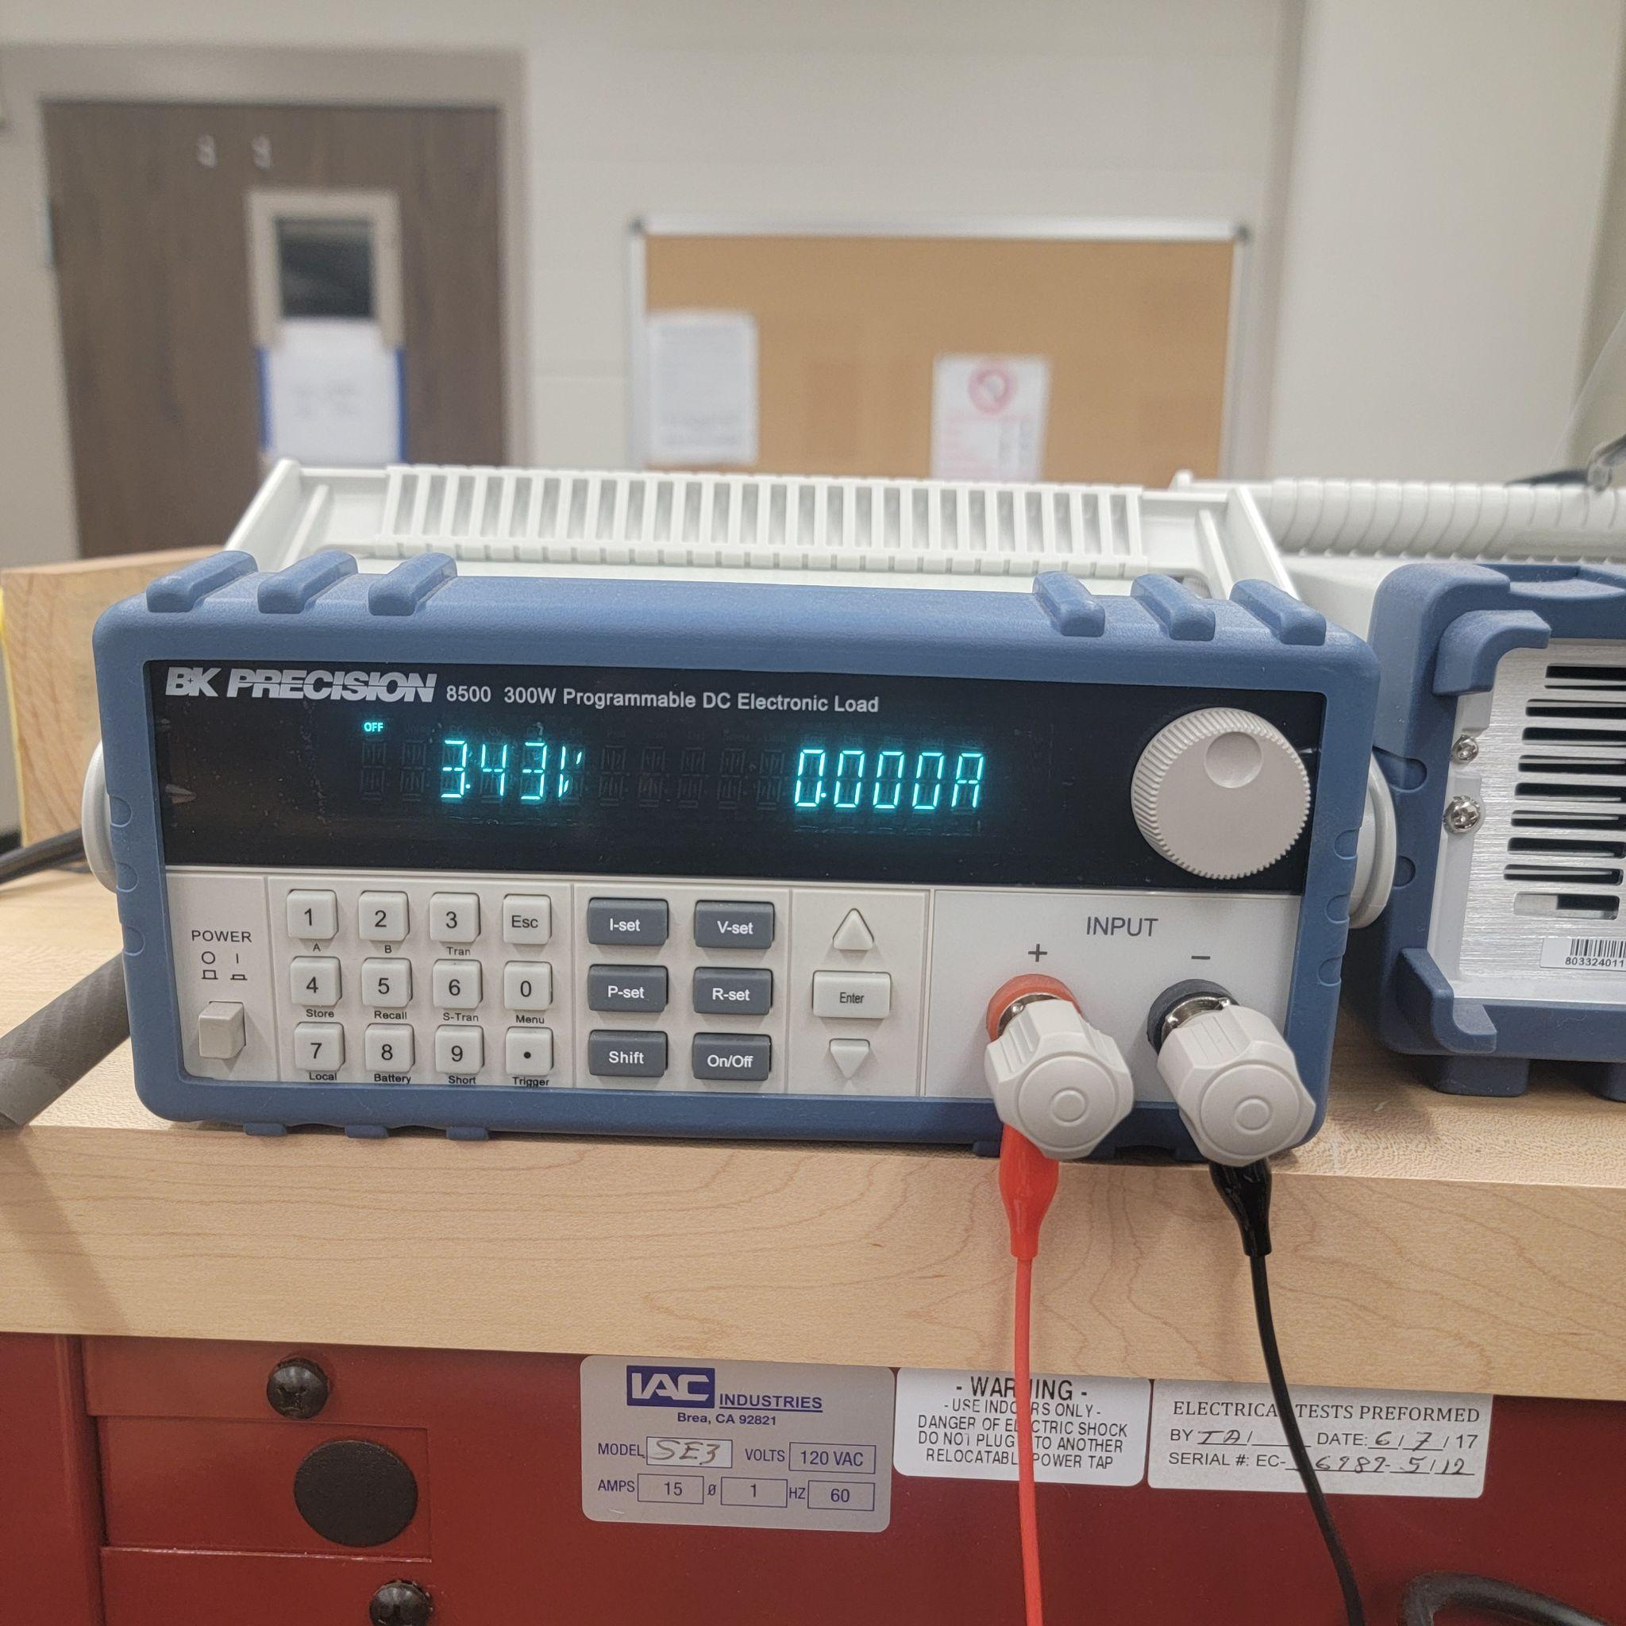
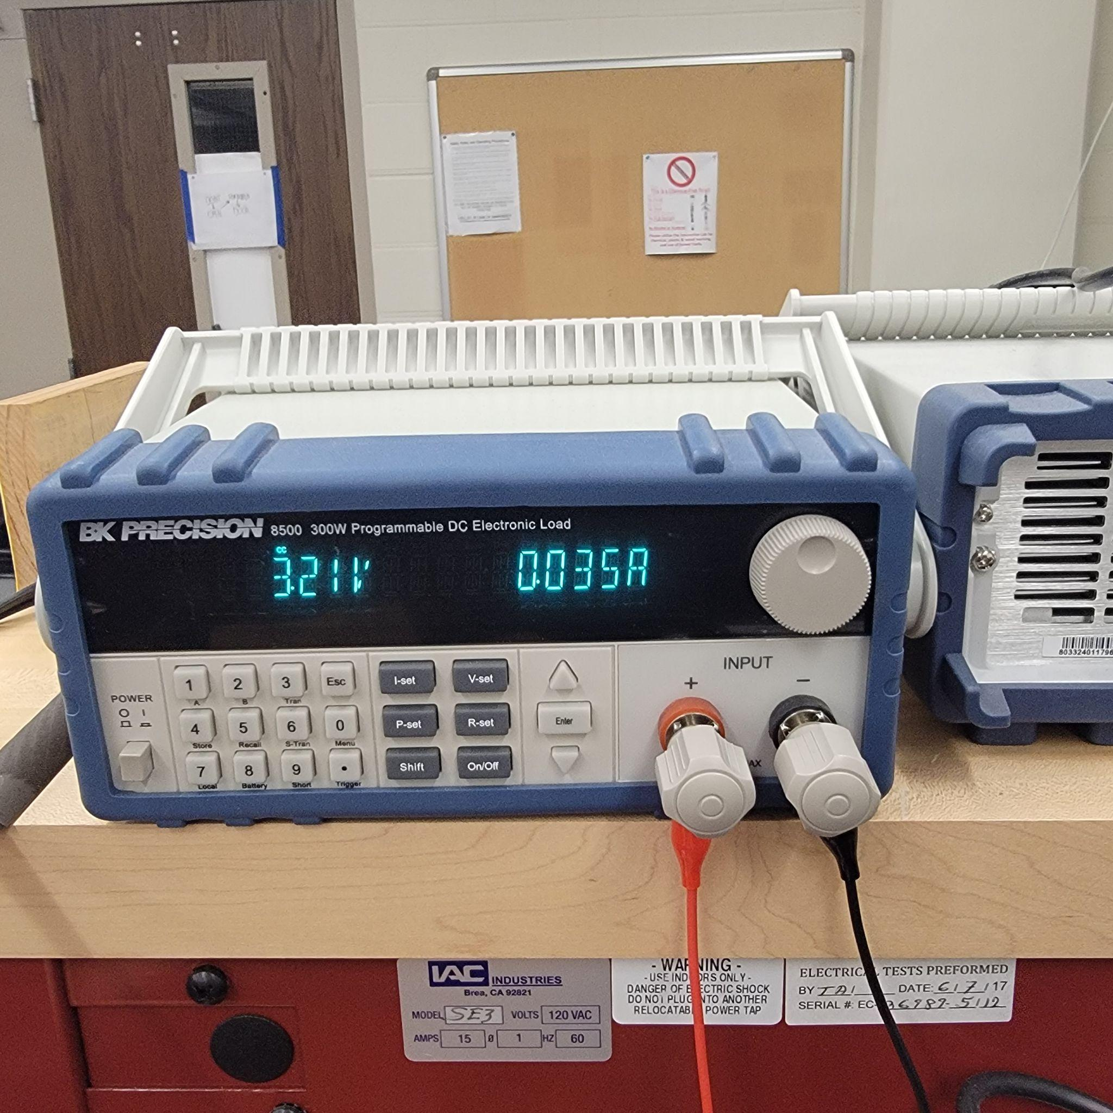
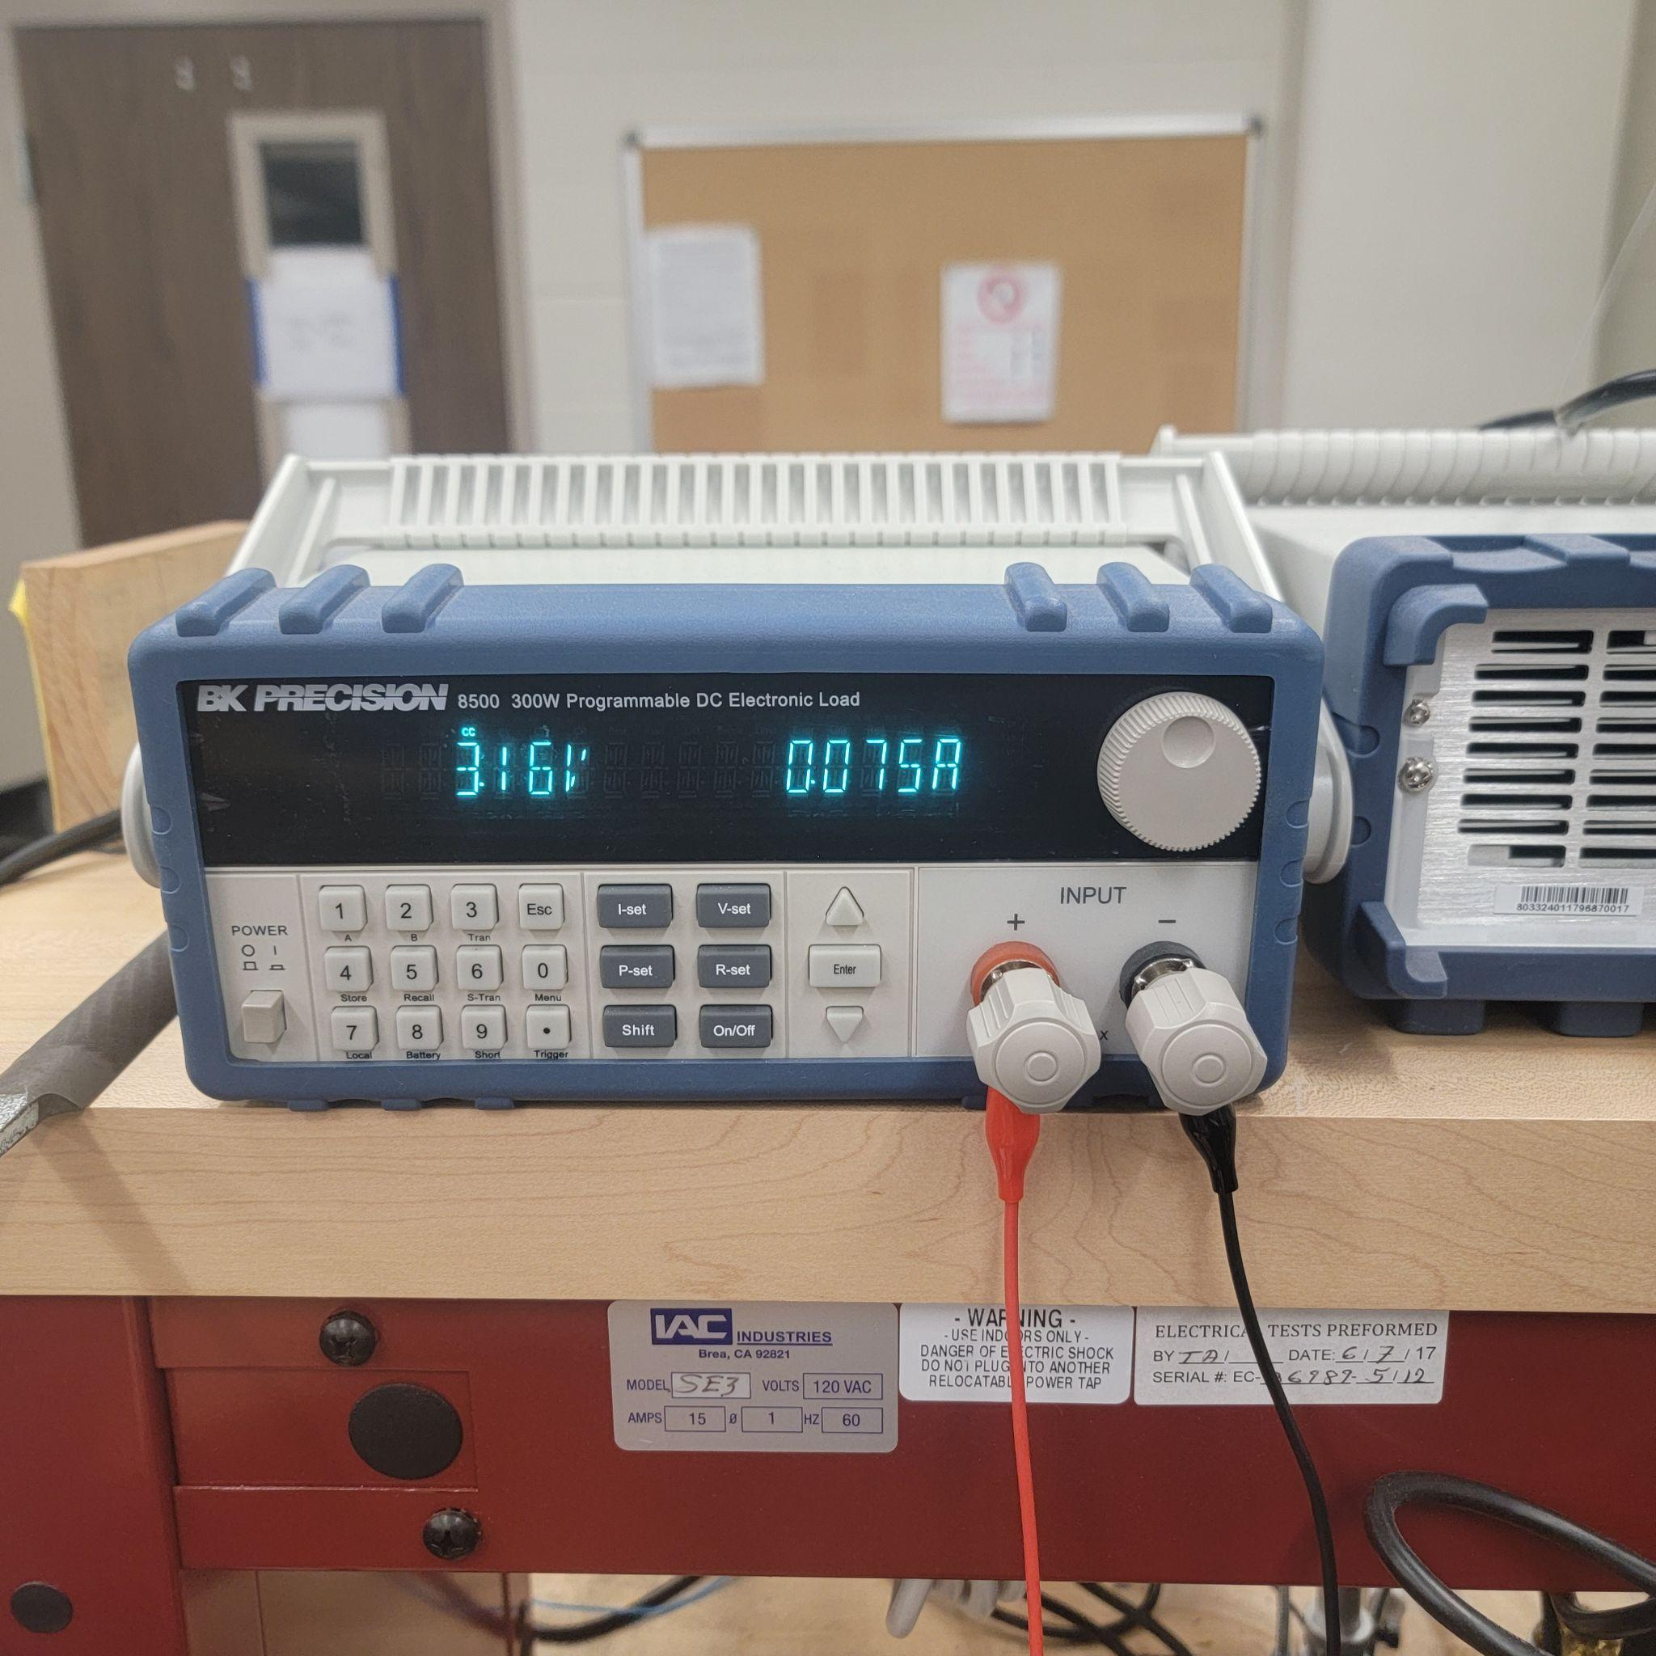
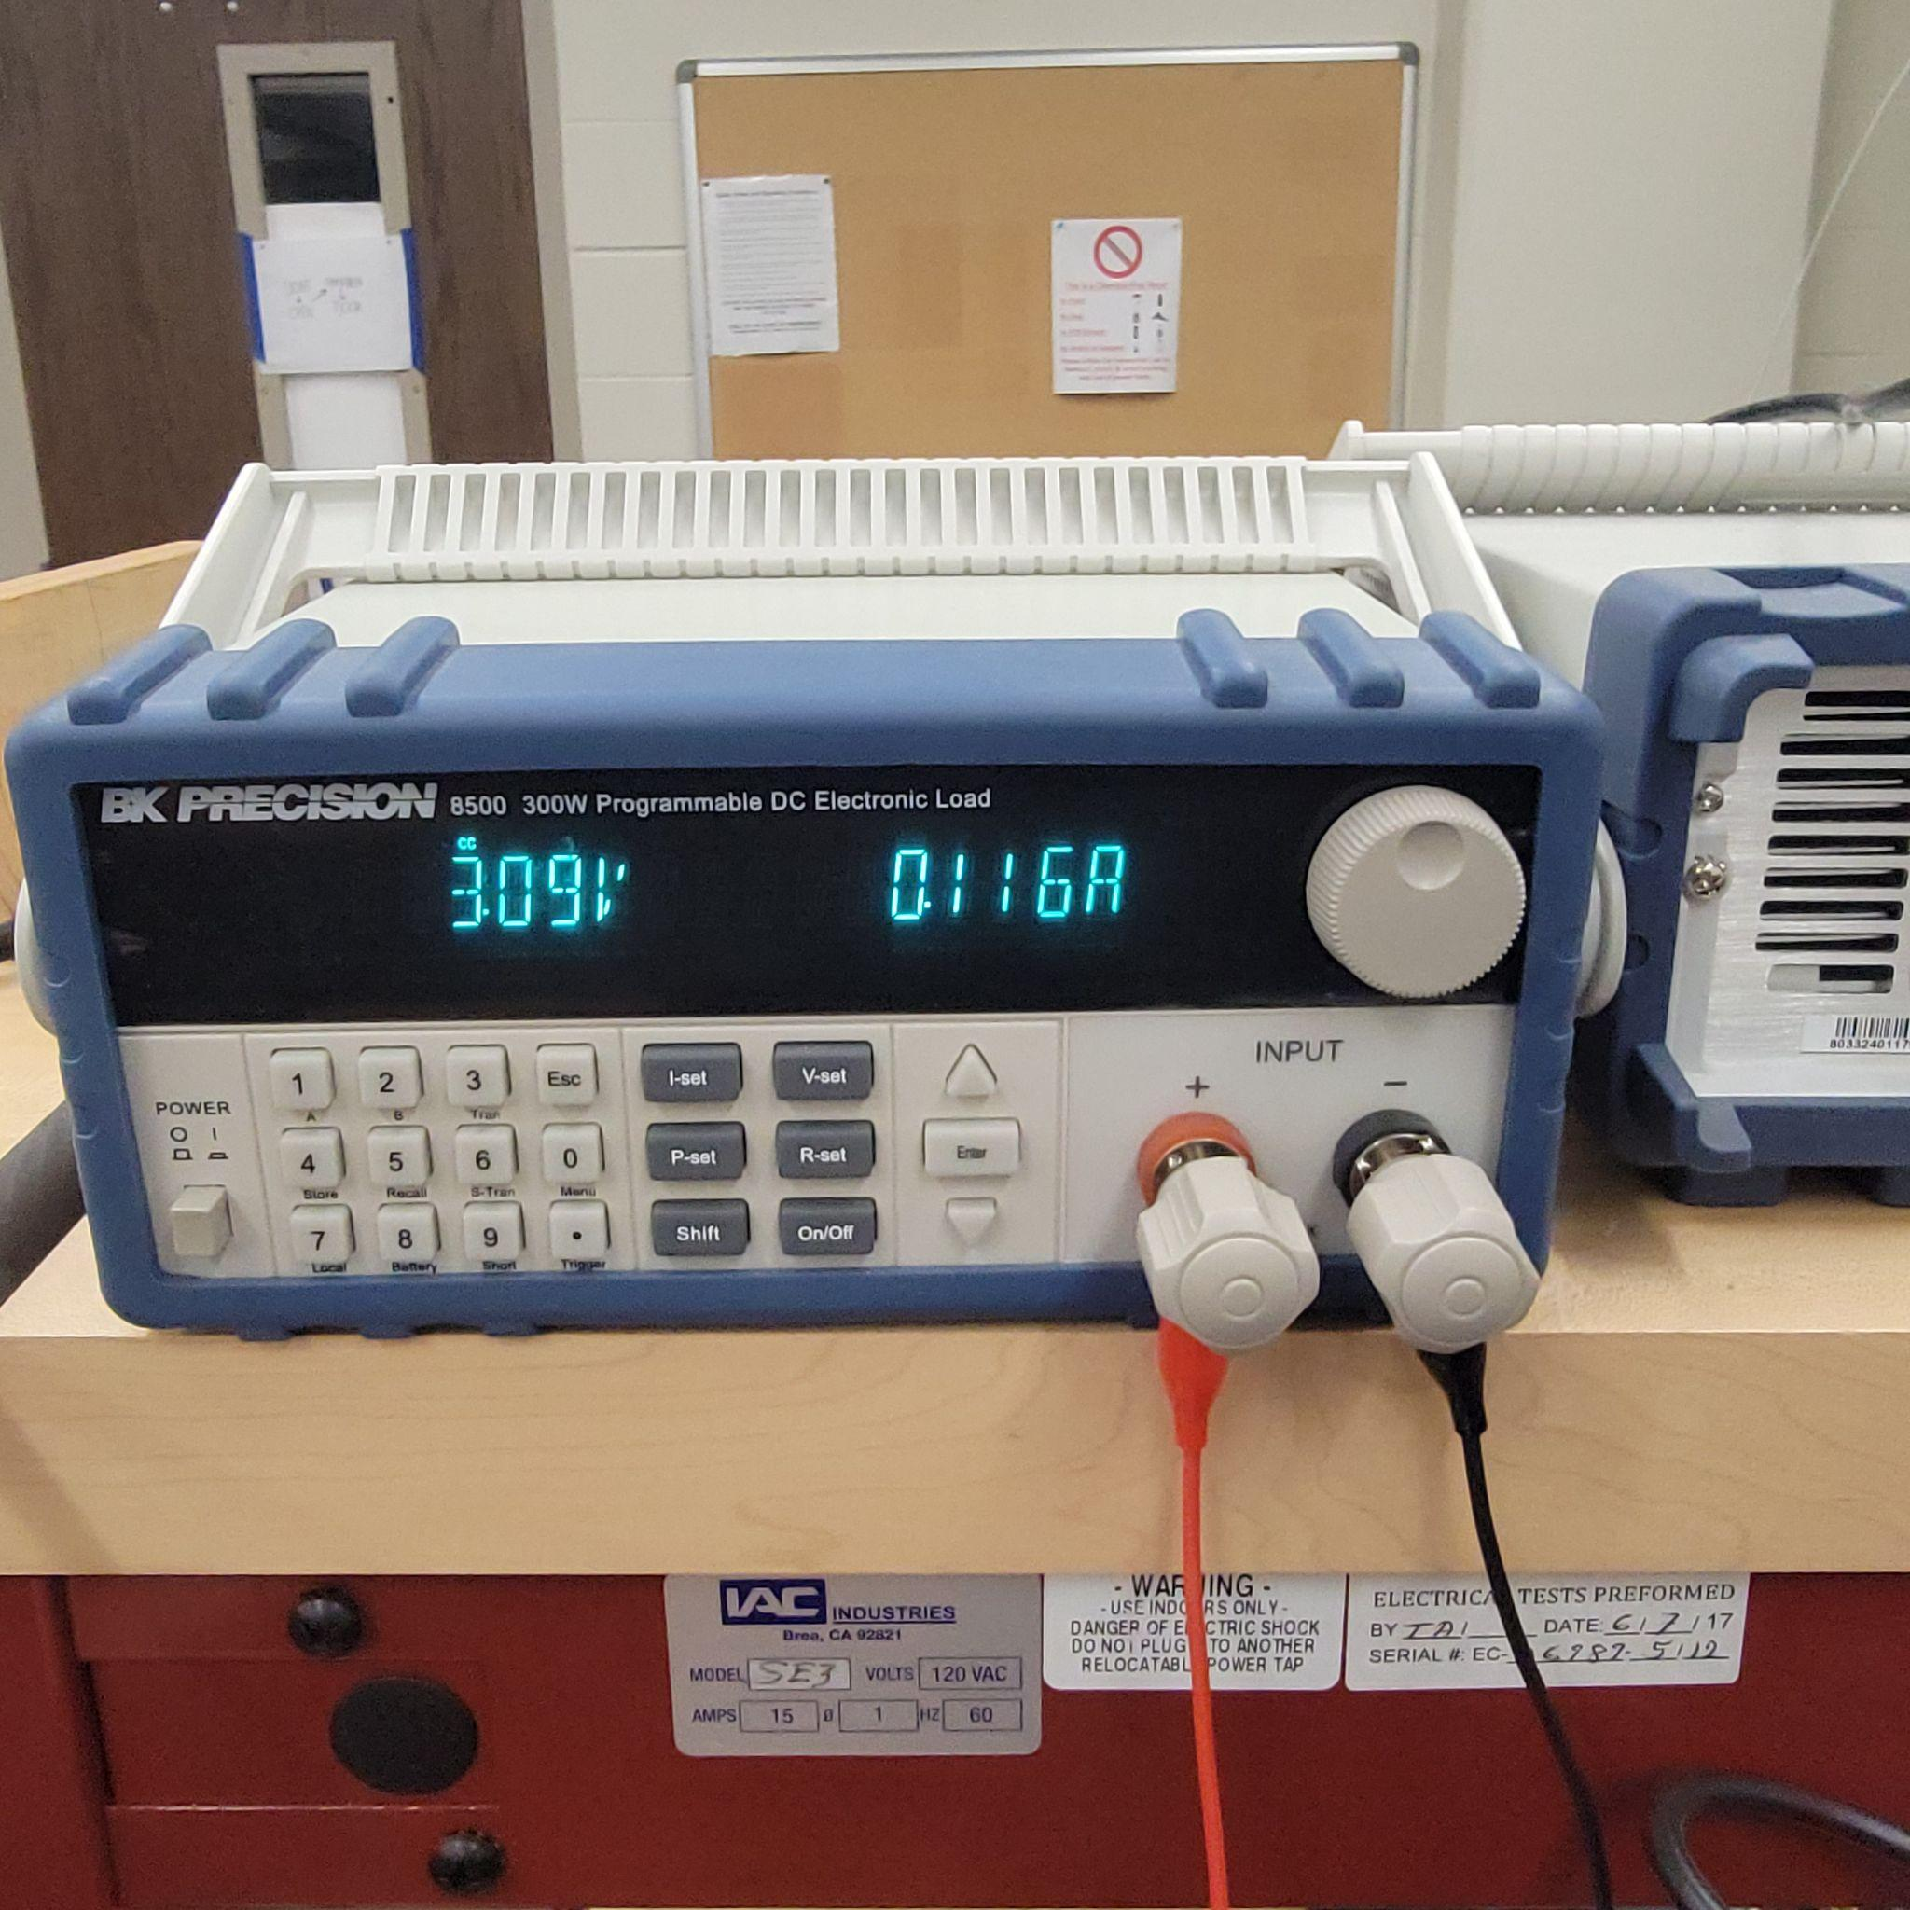
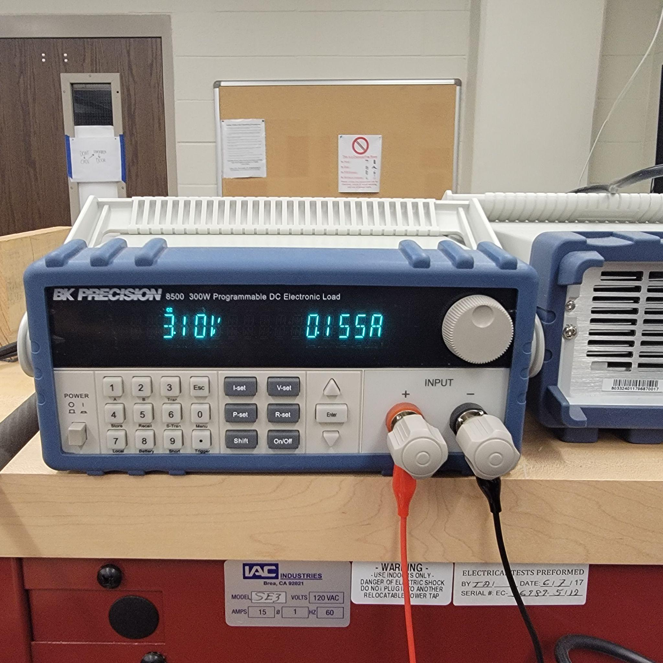
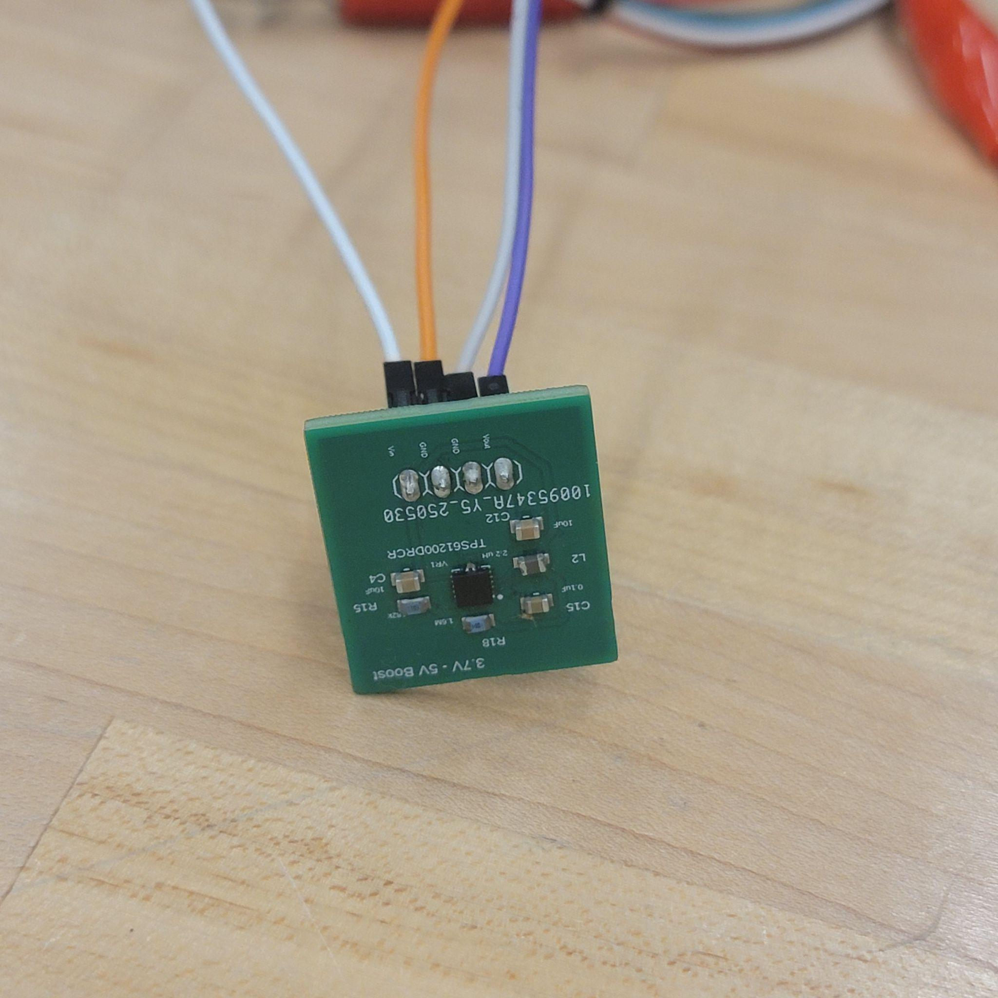

Slide 58
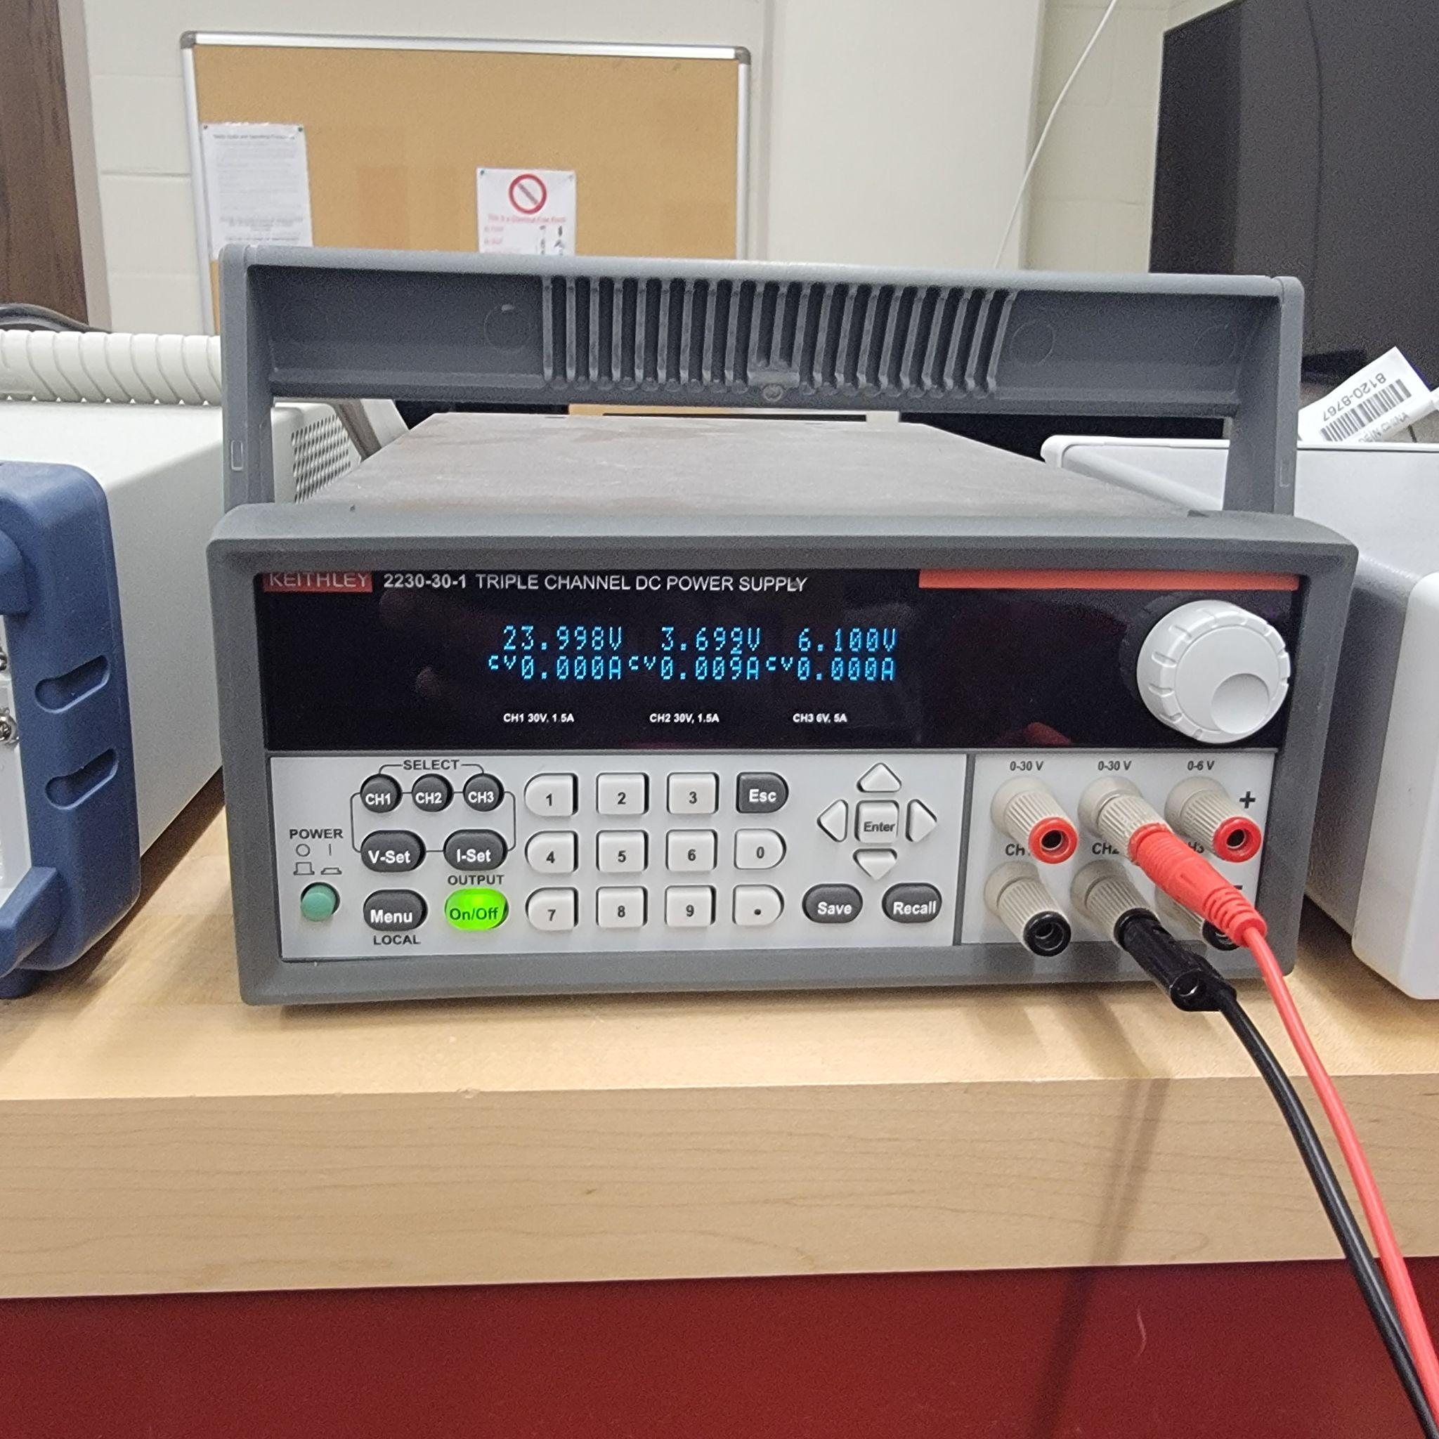
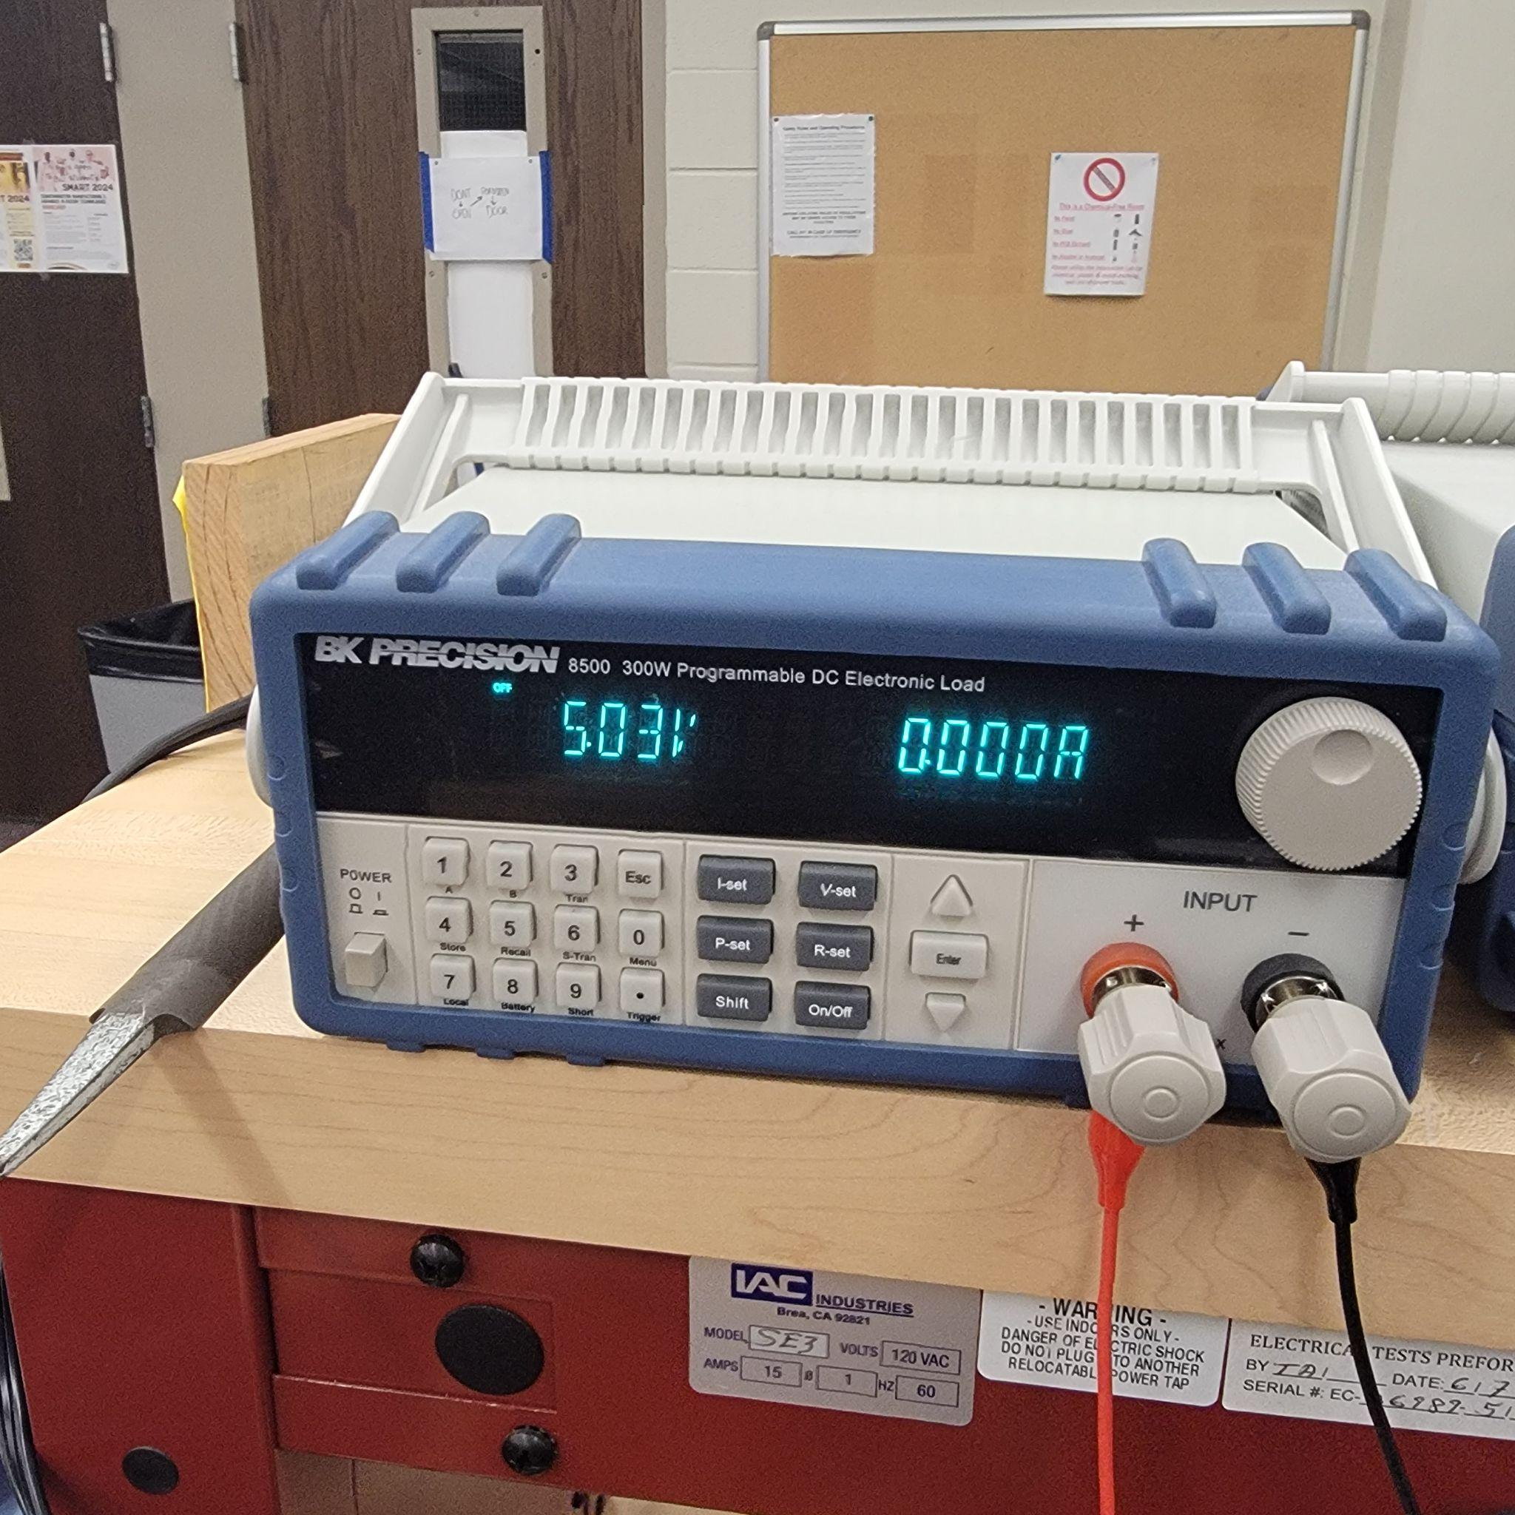
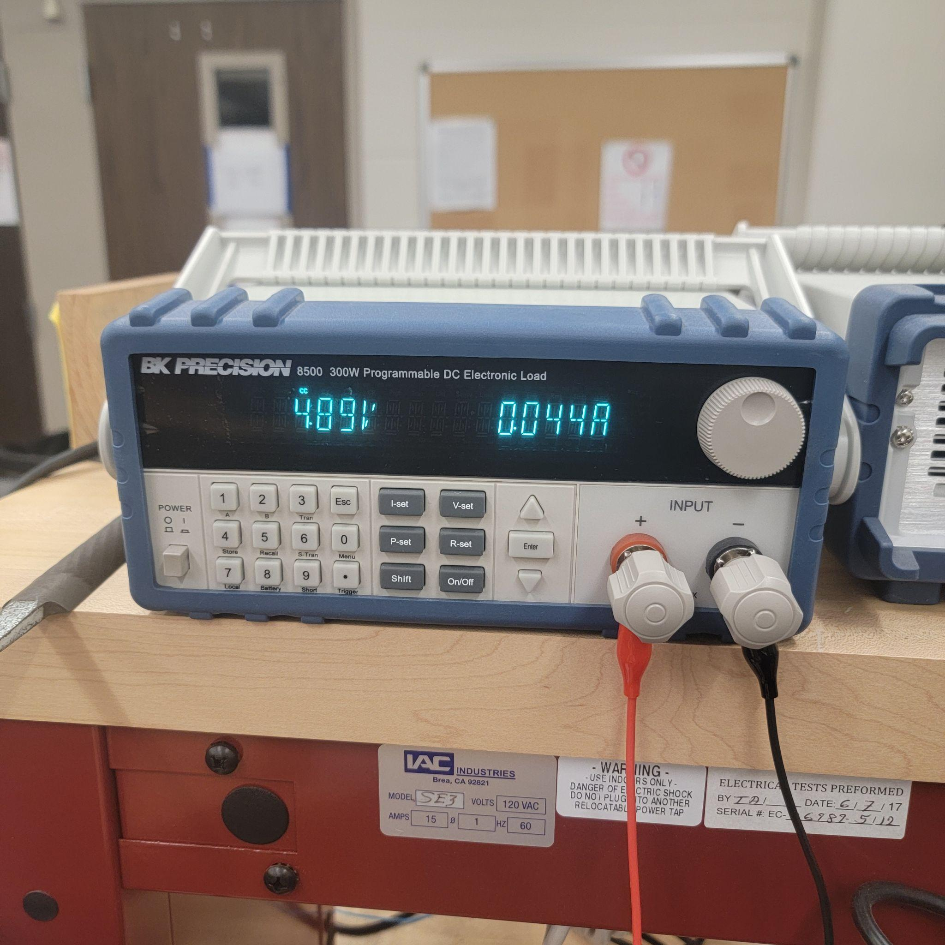
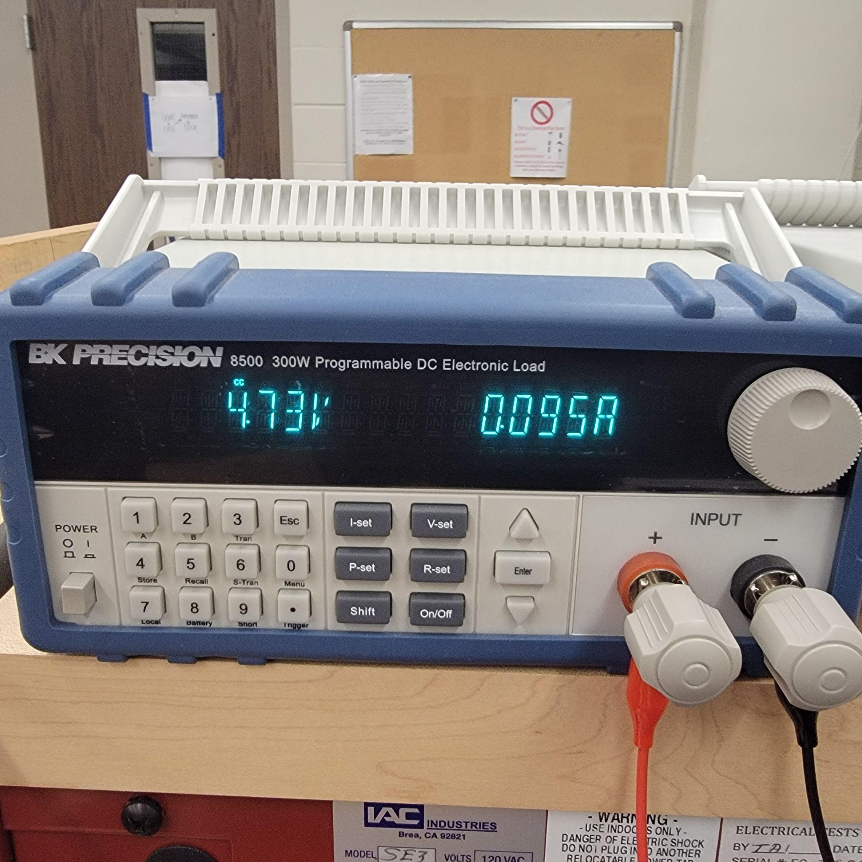
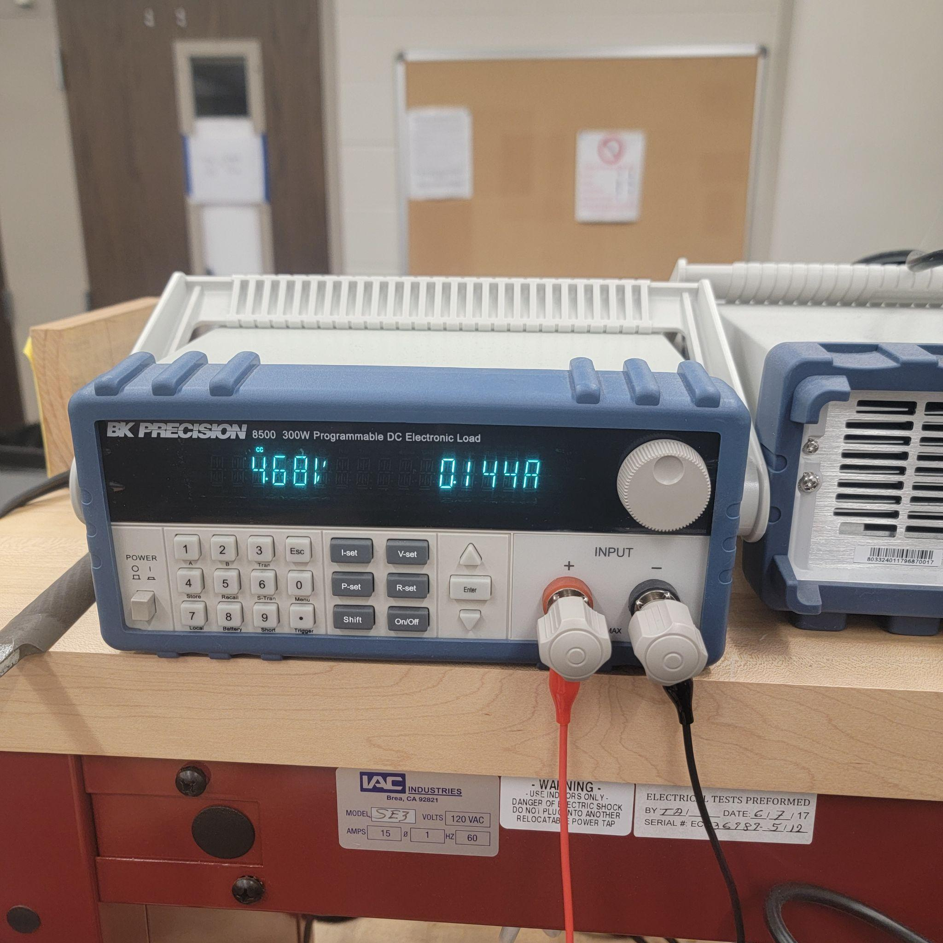


Slide 59
Power Consumption
Device | Current | Measured Voltage
Battery | 115 - 120 mA | 4V
5V Boost | 49 - 51 mA | 4V, 3.9 at input
3.7 to 3.3 V | 71 - 77 mA | 4V, 3.9 at input
VL53L1X ToF | 74.9 - 75.1 uA | 3.1V, 3.1 at input
Microphone | 1.3 - 6 uA | 3.1V, 3.1 at input
GPS Module | 52 - 58 mA (searching) | 3.1V, 3 at the input
Sharp IR Sensor | 7.6 mA | 5V, 4.7 at the input

Slide 60
Problems and Solutions
ESP 32 RAM Overload from TTS/STT Streams
  Google’s STT and TTS APIs require large in-memory buffers for PCM decoding and JSON parsing, quickly exhausting the ESP32’s ~520 KB of usable RAM.
  Resulted in heap fragmentation, buffer overflows, and frequent crashes
Unstable 3.7 V → Charging Module → 5V Regulation
  Encountered overheating in 5V TPS61200 regulator due to inrush current when connected to charging module at startup.
Audio Noise
  Observed audio noise in post-TTS waypoint command recordings

Slide 61
Problems and Solutions
Optimized TTS/STT Handling to Reduce Ram Usage
  Used SD card storage for large audio files to offload memory and optimize TTS/STT processing.
Improved power stability on our 5V Boost
  Resolved TPS61200 overheating by replacing undersized inductor with one rated for ≥1.2A to handle startup current properly.
Audio Noise
  Audio loss and delay issues were resolved by switching to Google’s TTS API and integrating an MP3 decoder from the Arduino library for smoother playback.

Slide 62
Success
End-to-End Voice Navigation Pipeline
  Implemented complete audio input-to-output flow on ESP32
  Voice commands triggered by real-time navigation responses via speech
Full Custom PCB Hardware Functionality
  All peripherals including ToF, Audio Amplifier, USB-UART and GPS Module Pcbs were fully functional as tested.
System API Functionality
  The Google TTS, STT, and Navigation APIs performed as intended
GPS Module Functionality
  Successfully prototyped GPS system using real-time coordinate date

Slide 63
Future Considerations
Memory Management
  Use a microcontroller with more Ram or dedicated audio co-processor
Sensor Selection
  Prioritize sensors with robust performance across diverse environments over those with longer range.
Power System Optimization
  Separate analog and digital power domains to reduce noise interference

Slide 64
All of the essential parts and components required for the construction of the SmartNav mobility stick with a total of $280 usd
Bill of materials
Component | Price | Quantity
PCB Board Orders | $ 150 | 5 Boards
PCB Components | $ 65
TP4056 charging module | $ 2 | 1
Regulators 3.3V | $ 6 | 2
Li-io Rechargeable Battery | $ 10 | 1
PUI Audio 3W 4Ω Mini Loudspeaker | $ 7 | 2
I2S Amplifier Module | $2 | 1
ESP 32 Wroom 32 | $5 | 1
Visually Impaired Assistive Cane | $12 | 1
GPS Module + Antenna | $39 | 2
Object Detection Sensor #1 & #2 | $12 | 2

Slide 65
Work Distribution
Evans Bakire | Deon McCoy | Sharifah Alselahi | Brennan Russell | Yussef Abdelbary
MCU PCB Design Regulators PCB Design Speech to Text & Text to Speech testing and integration Navigation System Implementation | GPS Module PCB Design GPS Module Software Integration Power Distribution Setup | I2s sound communication setup Sound system testing | ToF Sensor PCB Design Sensor Software Implementation and testing | Smartnav Housing 3d Design IR sensor Software testing and integration

Slide 66
Thank you! We’re happy to take questions.

